Slide 1
Visualizing your data
on the UCSC Genome Browser

Slide 2
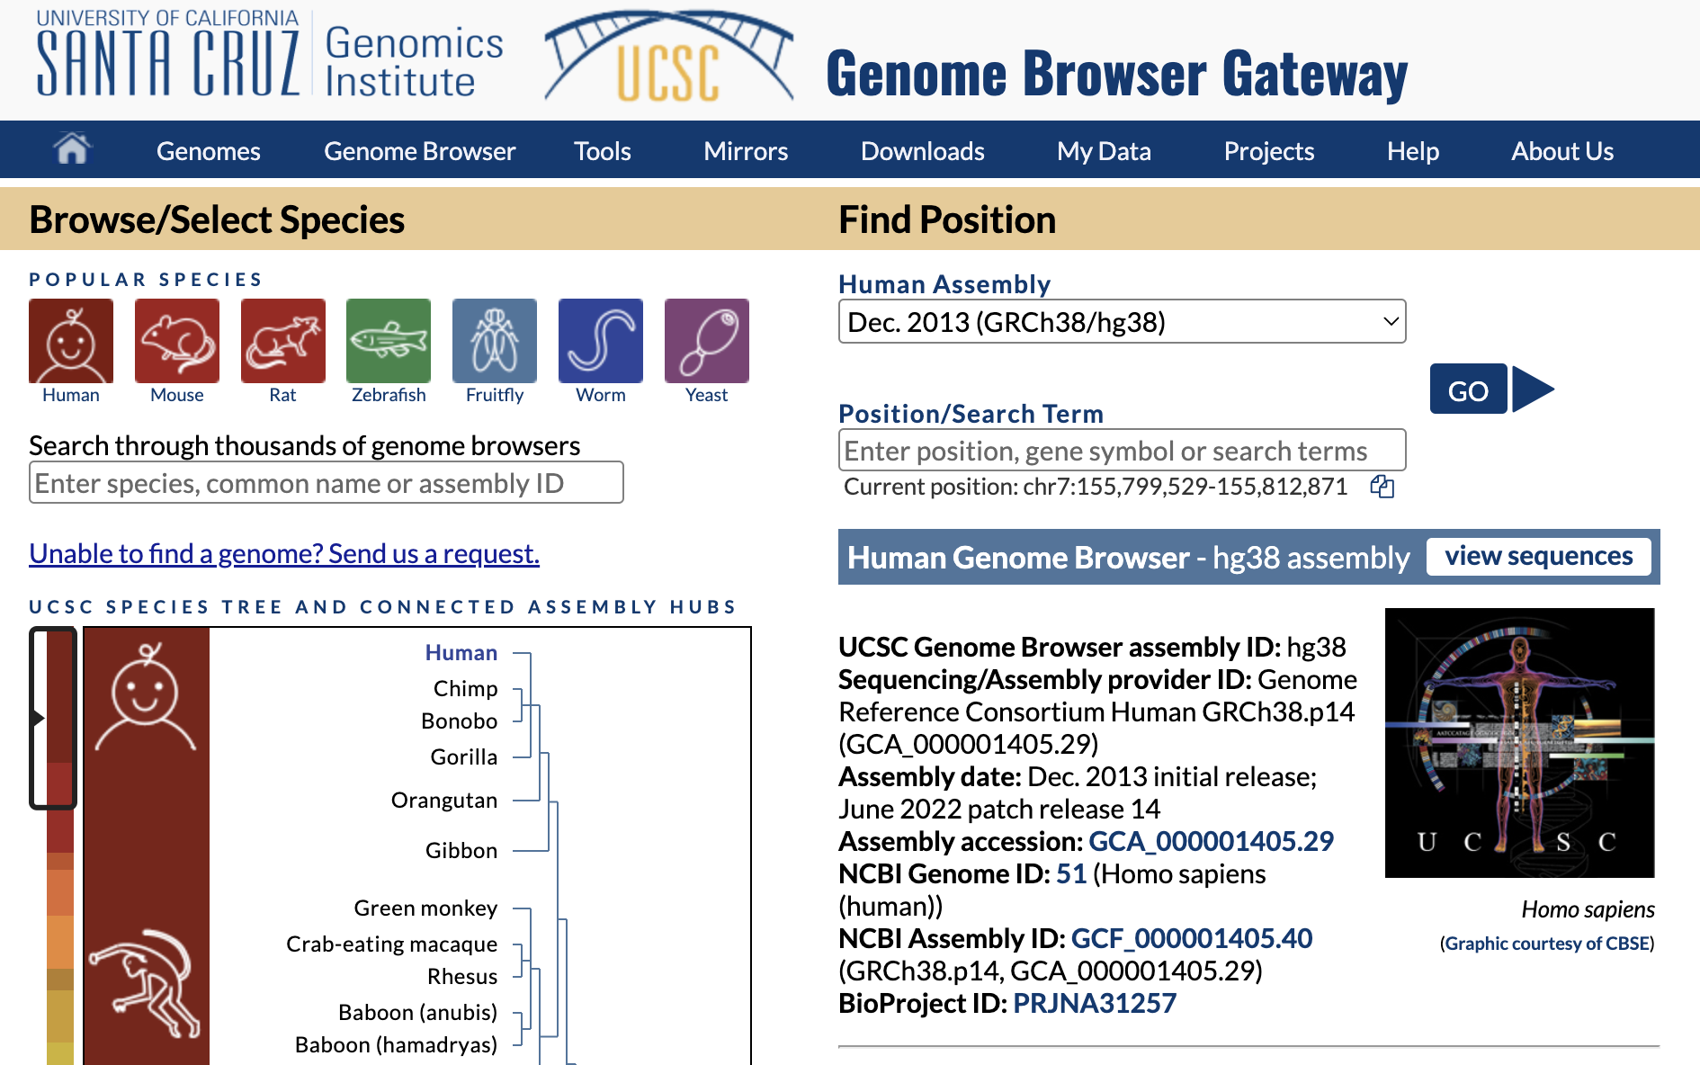
What is the UCSC Genome Browser?
Data visualization tool that displays annotations alongside a reference genome
220 genome assemblies
3,779 assembly hubs in GenArk

Slide 3
What type of data can I view?
Sequencing Data
BAM
WIG
Gene annotations
BED
genePred
GFF/GTF
Variant annotations
VCF
Tissue Expression
barChart

Slide 4
Supported Data Formats
Text-based:
Binary indexed:
BED
genePred
WIG
hic
bigBed
bigGenePred
bigWig
BAM
And much more!

Slide 5
How do I view the data?
Some terms used by the UCSC Genome Browser:
Custom Track
Track Hub
Assembly Hub

Slide 6
Custom Tracks
Benefits:
Useful to quickly view a small sample of the data
Temporary way to display the data
Text based data is human readable
Is uploaded directly to UCSC
Examples:
Limitations:
Are removed 48 hours since the last time they were accessed
Cannot upload binary index files directly to UCSC (big*)

Slide 7
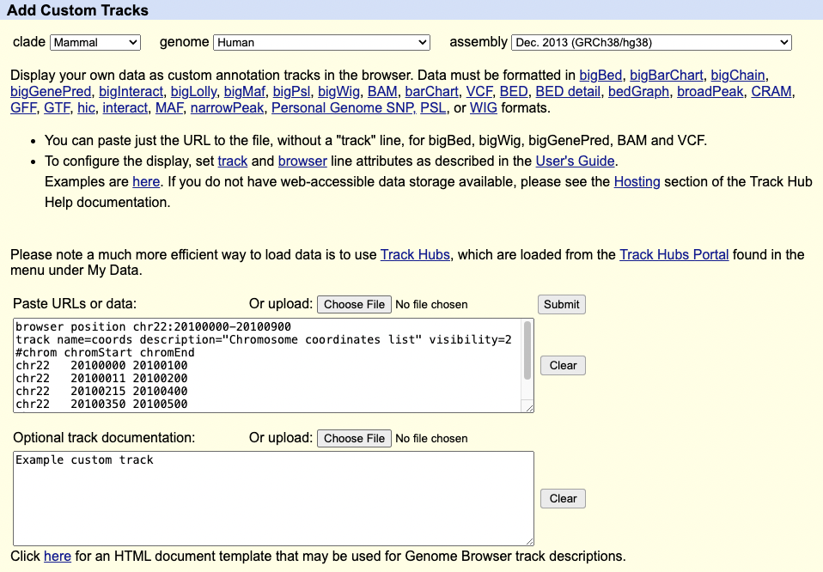
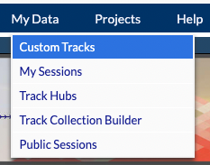
Using Custom Tracks
Visualization is defined in “track” and “browser” lines
Upload via the Custom Tracks page:
https://genome.ucsc.edu/cgi-bin/hgCustom

Slide 8
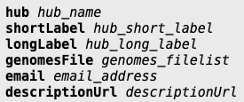
Track Hubs
Benefits:
Allows for greater control of the data
Various configuration options that are not available for custom tracks
Defined in three text files that can be modified
You are always in control of the data
Example:
-- hub.txt
-- genomes.txt
-- trackDb.txt
Limitations:
Data must be hosted remotely
Server must support byte-range requests

Slide 9
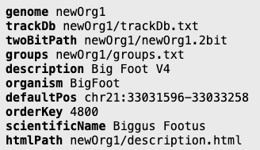
Assembly Hubs
Benefits:
Your own reference genome
Create your own track groupings
Add other tracks via track hubs
Example:
-- genomes.txt:
Limitations:
Same as track hubs
May require you to have a large amount of storage capacity

Slide 10
Where to Host the Data Remotely
-- Maximum size limit is 50 GB (uncompressed).
Server must accept byte-range request
Difficult for most free hosting services (piracy)
Your institution may be able to provide webspace
Free hosting options for researchers are available
5 GB of space for free, but can be relatively
-- slow to display. Offers a paid subscription
service to expand space.
-- Files limited to 100MB, but very fast.
Not limited and fast, but every file needs to be
-- uploaded individually and cannot be changed.
Optimal for very stable links, e.g. in publications.

Slide 11
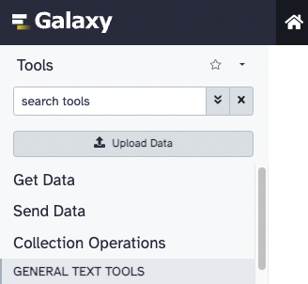
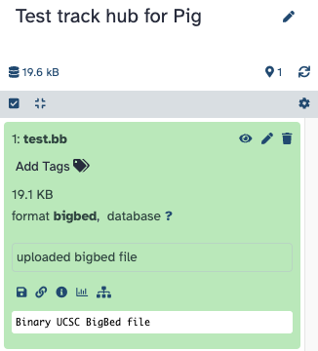
Step 1: Upload the Data
Depending on the hosting service, steps may vary.

Slide 12
Step 2: Create the Track Hub Files
useOneFile on
Use a single file instead of the required three files
hub.txt
genomes.txt
trackDb.txt

Slide 13
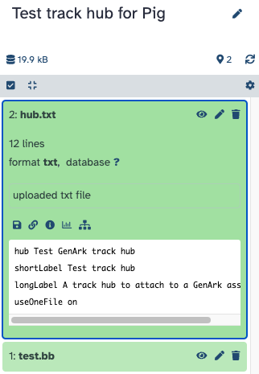
Step 3: Load the Hub Files to Server
Upload the track hub files to the remote server

Slide 14
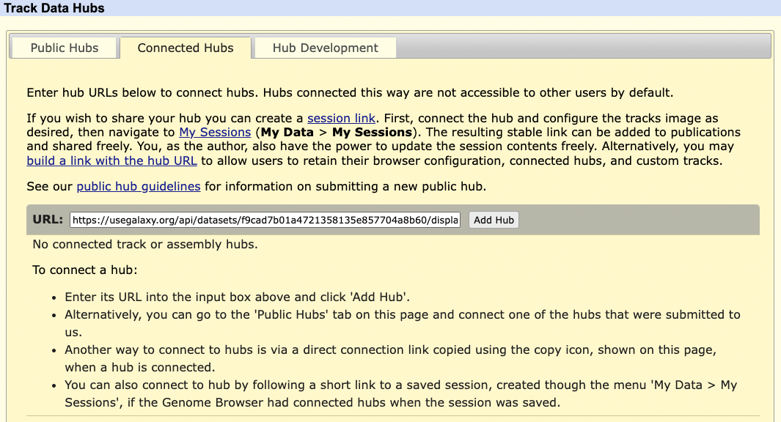
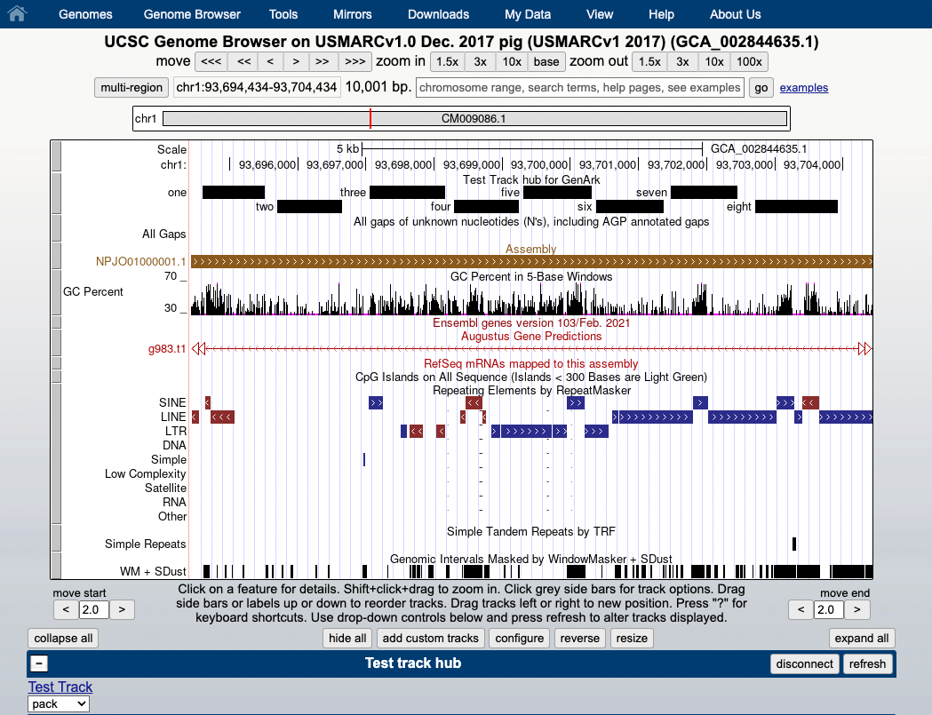
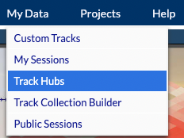
Step 4: View the Hub
Upload via the Track Hub Tracks page:
https://genome.ucsc.edu/cgi-bin/hgHubConnect

Slide 15
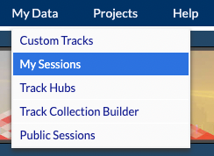
Step 5: Share the hub with others
All you need is the hub.txt URL to share with others
Hub.txt URL: https://usegalaxy.org/api/datasets/f9cad7b01a4721358135e857704a8b60/display?to_ext=txt
Can construct a URL that can be shared:
https://genome.ucsc.edu/cgi-bin/hgTracks?genome=GCA_002844635.1&hubUrl=https://usegalaxy.org/api/datasets/f9cad7b01a4721358135e857704a8b60/display?to_ext=txt

Slide 16
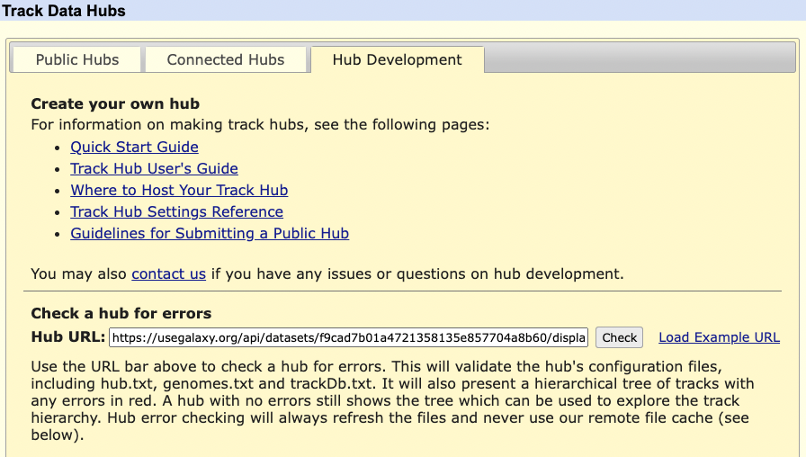
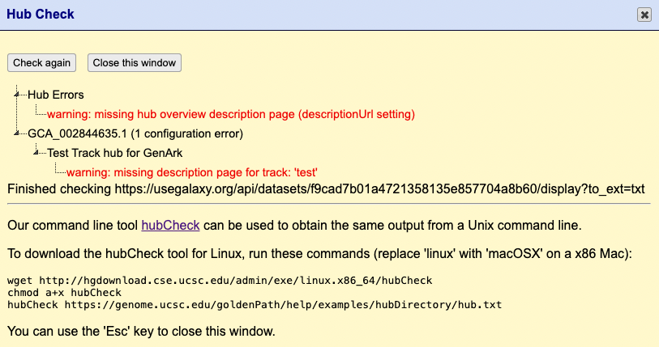
Checking the hub for errors
hubCheck utility can scan through your hub files and report any errors

Slide 17
Checking the hub for errors
hubCheck utility can scan through your hub files and report any errors
Command-line utility is even more verbose

Slide 18
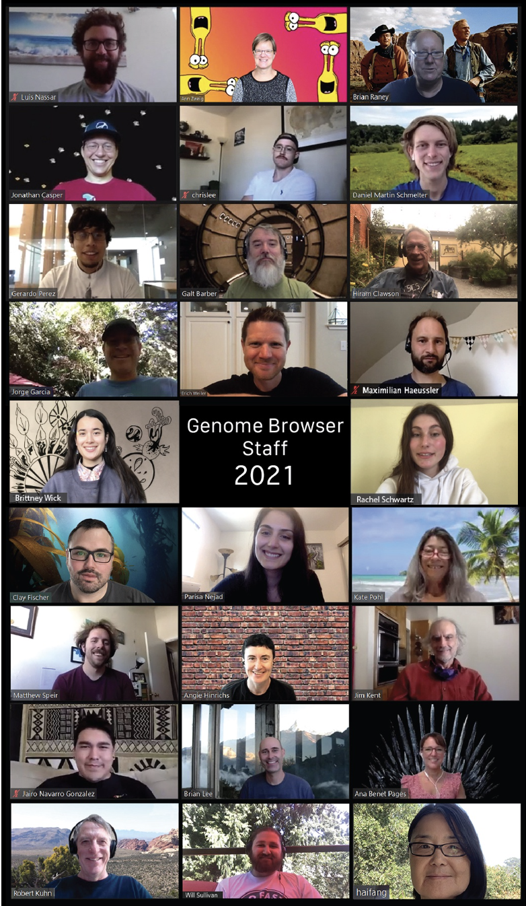
Thanks!
Contact us with your questions: genome@soe.ucsc.edu
Sensitive data: genome-www@soe.ucsc.edu

