Slide 1


GTEx in the UCSC Genome Browser
December 2016 Update
Kate Rosenbloom
UCSC Genome Browser Group

Slide 2
New Features (since July 2016)
Released GTEx Analysis Hub, showing Allele-Specific Expression summary tracks from Lappalainen Lab (August) News item
Added to EMBL/EBI Track Hub Registry (November)
Added GTEx gene expression to UCSC Gene Sorter tool (September)
Above tracks/data are hosted on hg19 (GRCh37) and hg38 (GRCh38) genome browsers. Track data is GTEx V6.

Slide 3
Allele-Specific Expression Summary Tracks
Allelic imbalance at the imprinted locus KCNQ1, evident in the GTEx cross-tissue
density graph, and in the cross-tissue and per-tissue sites display.

Slide 4
ASE Sites
ASE sites are colored by allelic imbalance value (gray for low AE, GTEx tissue color for high AE). Both H19 and CTSD loci shown here are highly expressed, but only H19 shows significant ASE. These genes are non-adjacent on chromosome 11, viewed together here via the Genome Browser multi-region feature (red vertical bar separates the two regions).

Slide 5
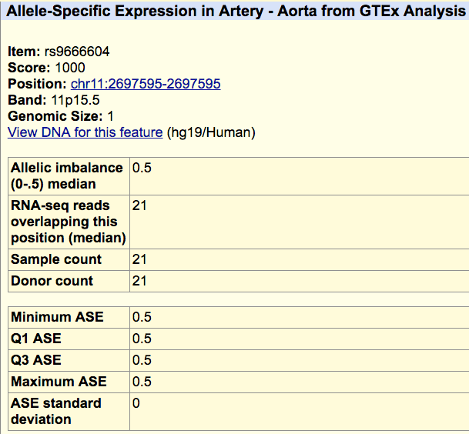
ASE site details
Clicking on an ASE site produces a page with auxiliary information, as in this example;
where variant rs9666604 shows maximum allelic imbalance in all GTEx aorta samples

Slide 6
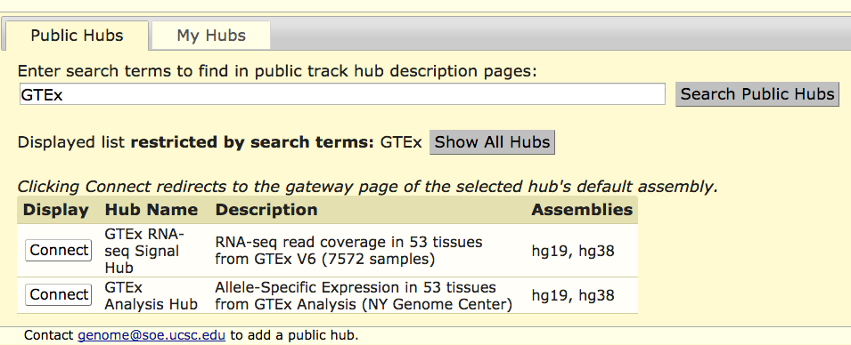
Finding GTEx ASE Tracks at UCSC
Track Hub Search page

Slide 7
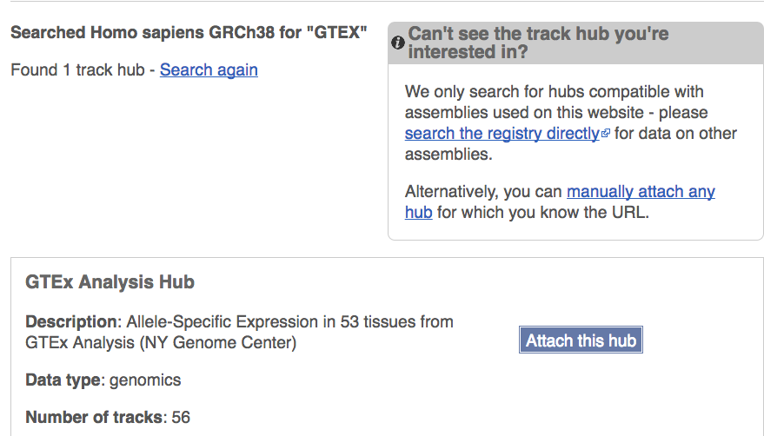
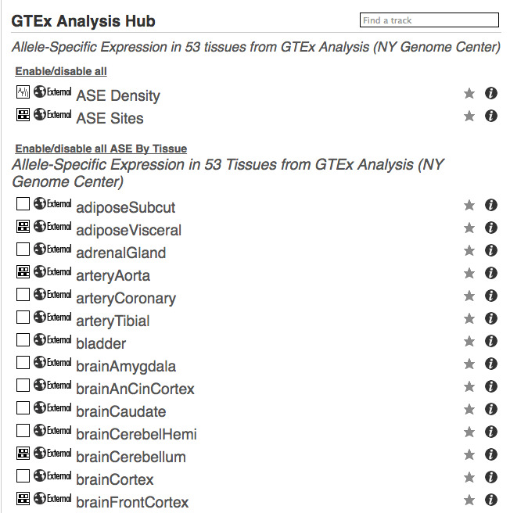
GTEx ASE at the Ensembl Track Registry
http://beta.trackhubregistry.org/

Slide 8
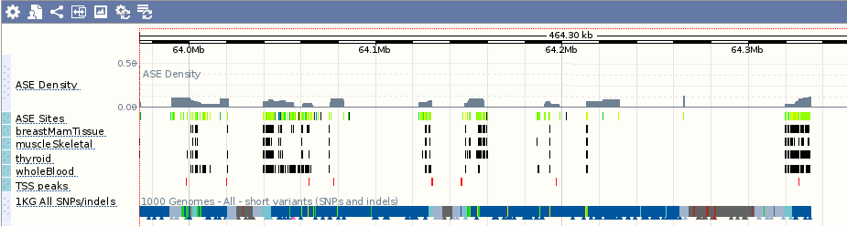
GTEx ASE tracks displayed from Ensembl genome browser

Slide 9
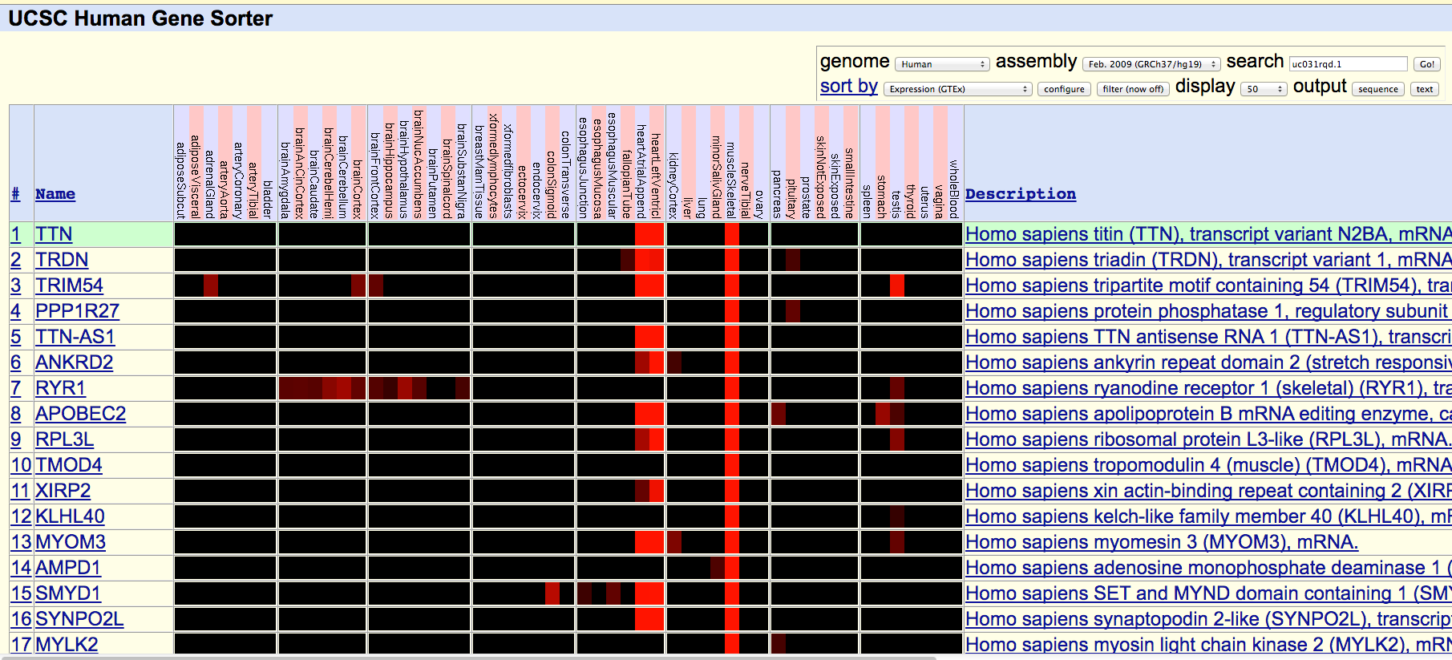
GTEx gene expression view in UCSC Gene Sorter Tool
The Gene Sorter provides similarity ranking of genes based on a broad range of datasets
and metrics. In this screenshot, genes similar to the titin gene based on GTEx gene
Expression are listed, along with the median expression level in each GTEx tissue, using
microarray gene expression display conventions (red highly expressed).

Slide 10
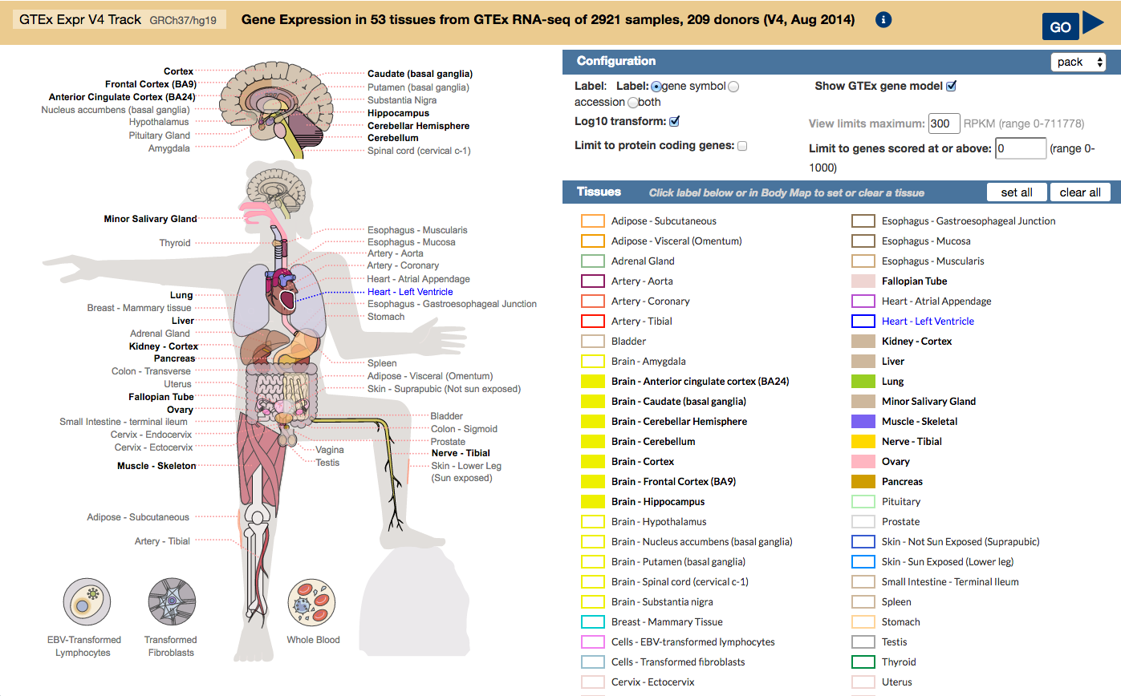
In Progress: ‘Body Map’ of GTEx tissues
UCSC has commissioned artwork to improve user selection of tissues. We plan to make
the GTEx ‘Body Map’ freely available in SVG format at Wikimedia Commons.

Slide 11
Future Plans
V6p: Gene expression quantifications from the newer analysis pipeline will be incorporated into a track which will be viewable alongside the existing V6 track
eQTL Tracks: Design work in progress, in collaboration with Casey Brown, GTEx ASE

Slide 12

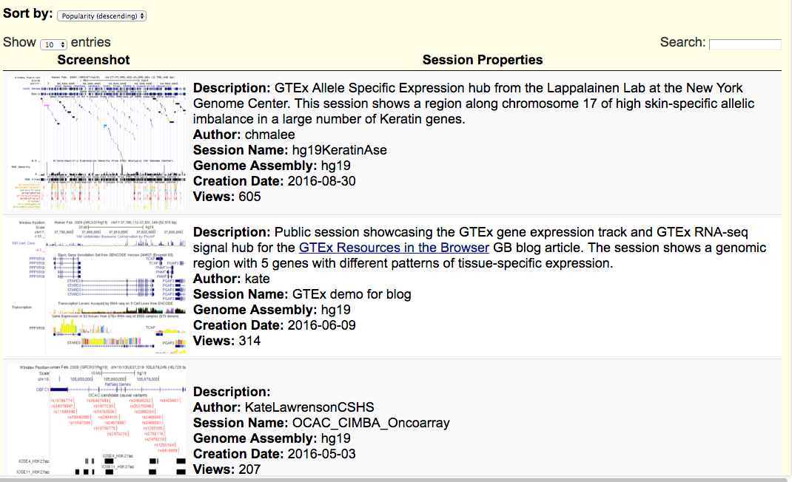
Outreach
http://genome.ucsc.edu/cgi-bin/hgPublicSessions
The UCSC Genome Browser provides a web page where users post sessions for public viewing. Two GTEx-related sessions are currently the most visited on this page.

Slide 13
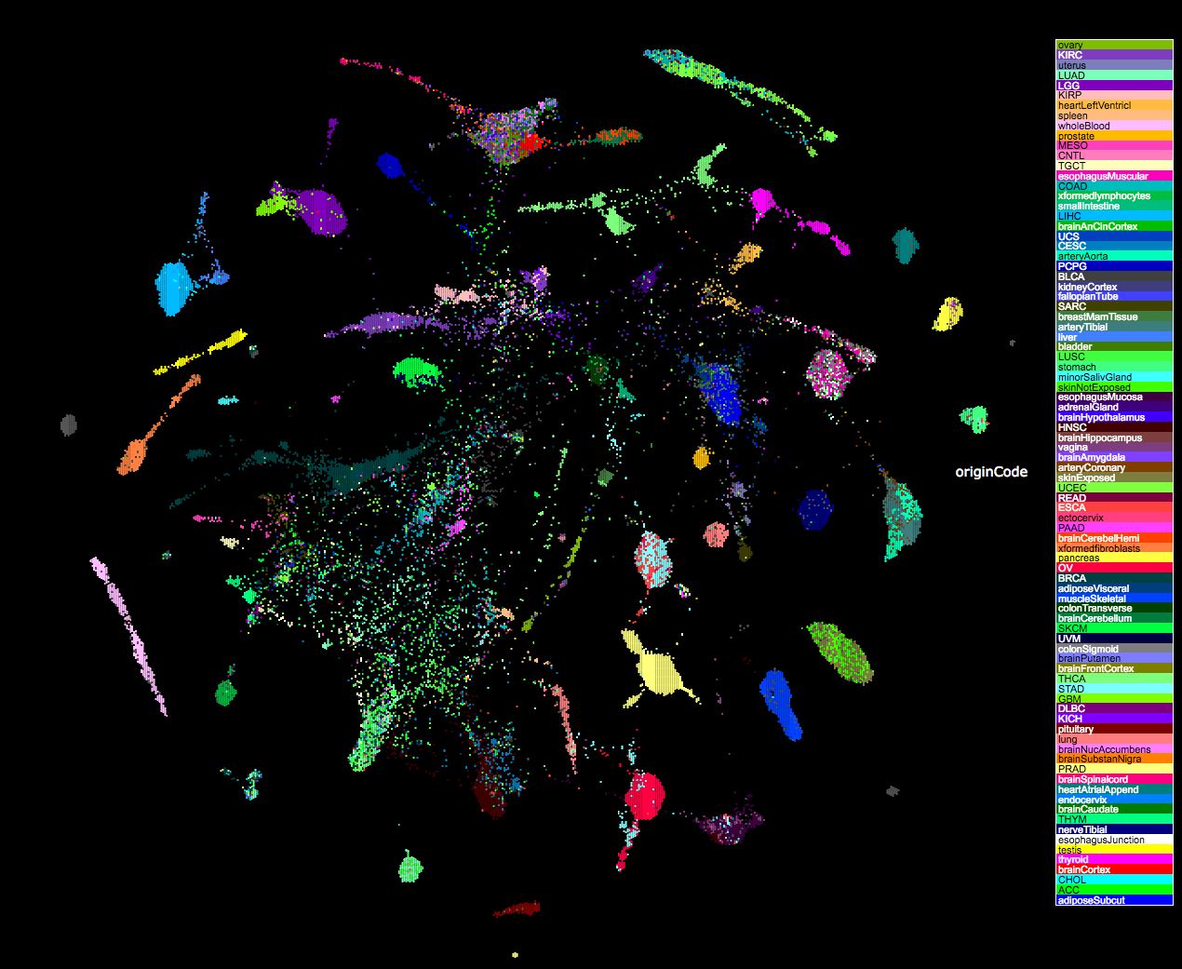
Related Work: Clustering GTEx + TCGA
tumormap.ucsc.edu
Yulia Newton, Teresa Swatlowski (Stuart Lab at UCSC)

Slide 14
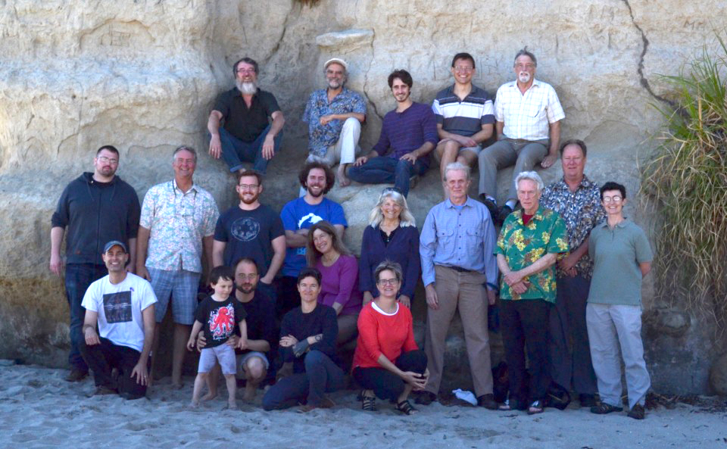
Acknowledgements
Colleagues: UCSC Genome Browser group PI: Jim Kent
Chris Lee of the UCSC QA team reviewed and released the GTEx ASE hub and Gene Sorter view
Collaborators: GTEx LDACC, Consortium and Analysis Group
Stephane Castel and Tuuli Lappalainen (NY Genome Ctr) for ASE tracks.
Andy Yates and Alessandro Vullo of Ensembl for assistance incorporating GTEX ASE hub into EBI Track Registry.
Funding: NHGRI (5 U41 HG002371-16 to UCSC Center for Genomic Science)

Slide 15


UCSC Browser Help
Send us a message to our public mailing list:
genome@soe.ucsc.edu
View training info, videos, and user’s guides:
http://genome.ucsc.edu/training/
Find us on: Genome Browser
@GenomeBrowser
UCSC Genome Browser
More information:
Send us a message on our public mailing list:
genome@soe.ucsc.edu
View training info, videos, and user’s guides:
http://genome.ucsc.edu/training/
Find us on:
GenomeBrowser
@GenomeBrowser
UCSC Genome Browser
More information:
Send us a message on our public mailing list:
genome@soe.ucsc.edu
View training info, videos, and user’s guides:
http://genome.ucsc.edu/training/
Find us on:
GenomeBrowser
@GenomeBrowser
UCSC Genome Browser
More information:
Send us a message on our public mailing list:
genome@soe.ucsc.edu
View training info, videos, and user’s guides:
http://genome.ucsc.edu/training/
Find us on:
GenomeBrowser
@GenomeBrowser
UCSC Genome Browser

Slide 16
GTEx ASE Track methods
The ASE Density track provides a cross-tissue summary of ASE via a density graph of median allelic imbalance across all tissues in a sliding window.
The ASE Sites track shows all SNPs with evidence of ASE in any tissue. Each site is identified by the SNP ID, or if none assigned, then by chromosomal start position.
The ASE by Tissue track contains a subtrack showing ASE sites for each of the 53 tissues assayed. Sites are colored based on the median ASE for the site across all samples of the tissue; shaded from gray (low) to the GTEx convention tissue color (high) with an intermediate color representing moderate ASE level.

