Slide 1
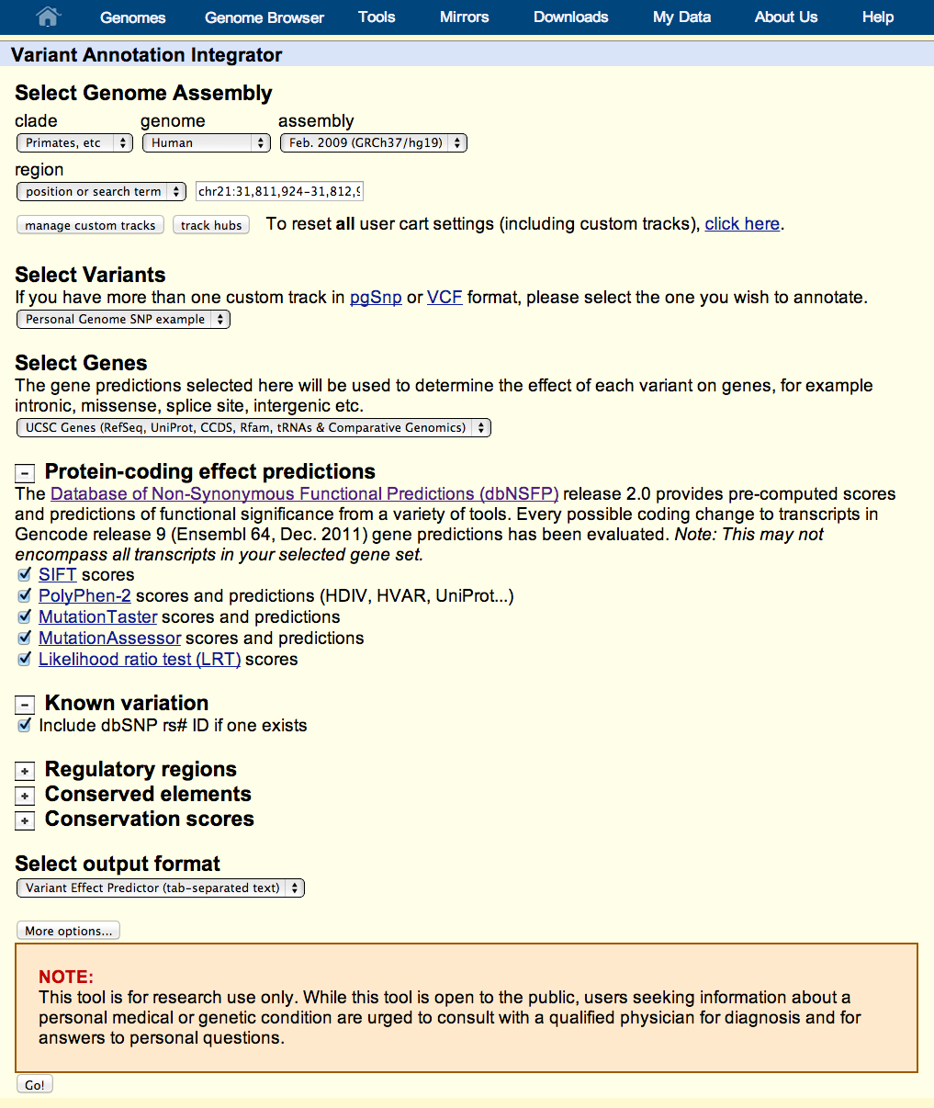
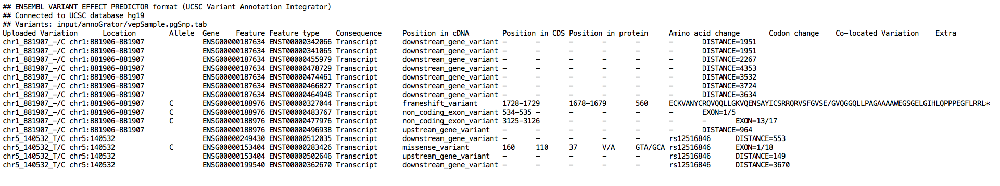
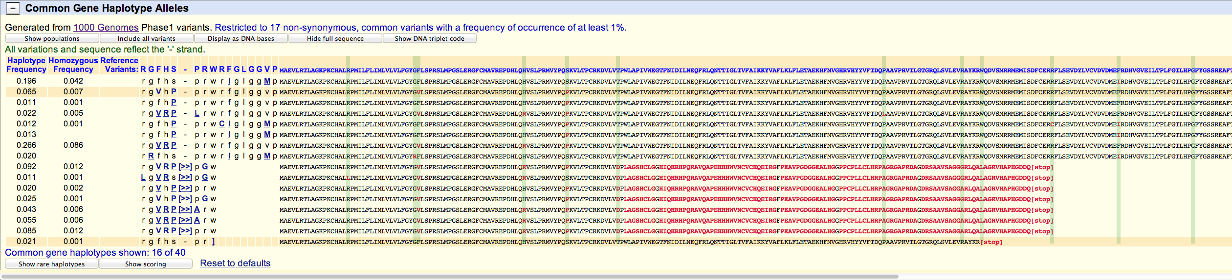


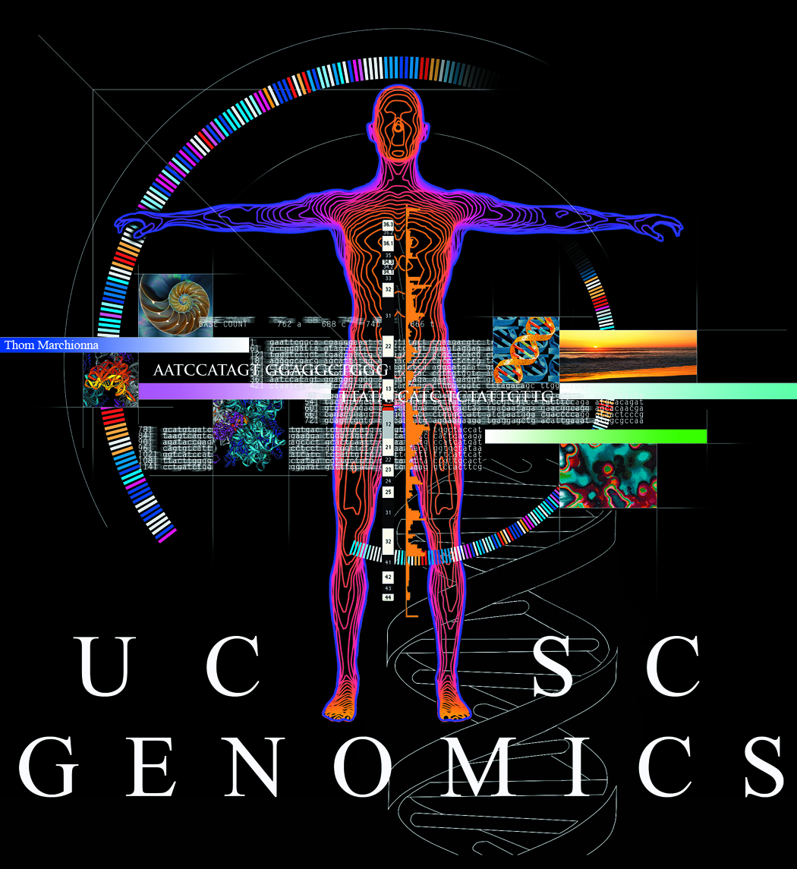
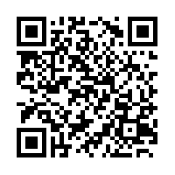
New variation resources at the UCSC Genome Browser
Brooke Rhead, Angie S. Hinrichs, Timothy R. Dreszer, Brian J. Raney, Robert M. Kuhn, Ann S. Zweig, Donna Karolchick, W. James Kent
Annotate your variants:
Upload variants:
track type=pgSnp visibility=3 db=hg19 name="pgSnp" description="Personal Genome SNP example"
browser position chr21:31811924-31812937
chr21 31812007 31812008 T/G 2 21,70 90,70
chr21 31812031 31812032 T/G/A 3 9,60,7 80,80,30
chr21 31812035 31812035 -/CGG 2 20,80 0,0
chr21 31812088 31812093 -/CTCGG 2 30,70 0,0
chr21 31812277 31812278 T 1 15 90
chr21 31812771 31812772 A 1 36 80
chr21 31812827 31812828 A/T 2 15,5 0,0
chr21 31812879 31812880 C 1 0 0
Download variants with predicted functional effects and annotations from UCSC Genome Browser data tracks, including custom tracks:
View gene alleles (haplotypes) from 1000 Genomes data:
Click on a gene in the UCSC Genes track:
Scroll to new section:
Haplotype and homozygosity frequencies.
Summary of variants in each haplotype allele.
Sequences with predicted effects. Variants are highlighted by vertical lines, and changes to the predicted amino acid sequence are highlighted in red. This gene (ABO) shows a frameshift mutation in several haplotypes.
This work is funded by the National Human Genome Research Institute award U41HG002371 to the UCSC Center for Genomic Science.
See our wiki for more details:
http://genomewiki.ucsc.edu/index.php/BoG2013VariationPoster

