Slide 1
topic for today
UCSC GenArk collection of genome assemblies
Presenter: Hiram Clawson – U.C. Santa Cruz Genomics Institute
hclawson@ucsc.edu
our work is supported by a number of different grants:
National Human Genome Research Institute U41HG002371
National Human Genome Research Institute U24HG002371
Silicon Valley Community Foundation 2017-171531(5022)
National Institute of Allergy and Infectious Diseases
NIAID 75N93019C00076 AWD100477
Notes:
Topics in this presentation: 1. GenArk collection of genome assemblies

Slide 2
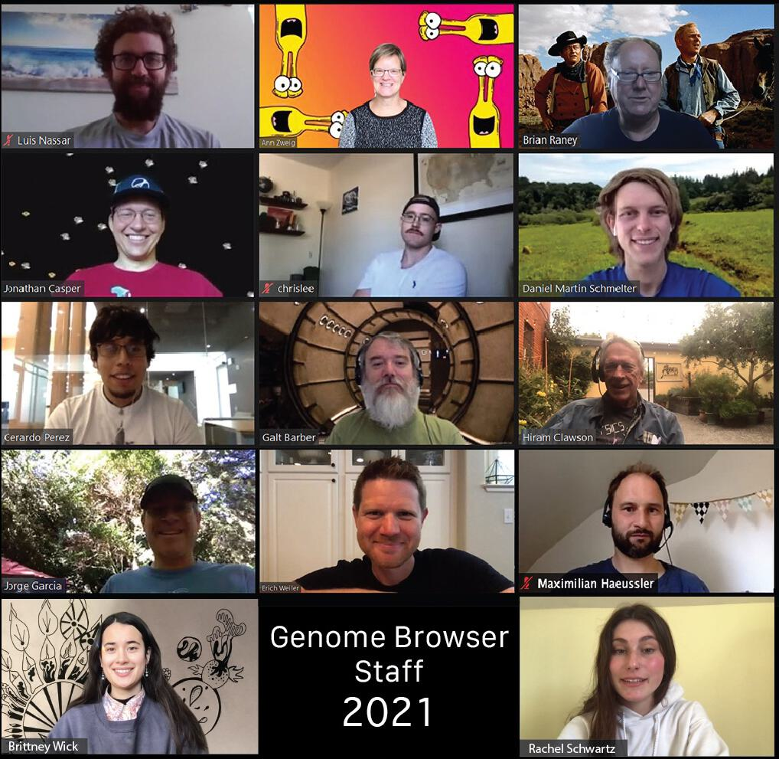
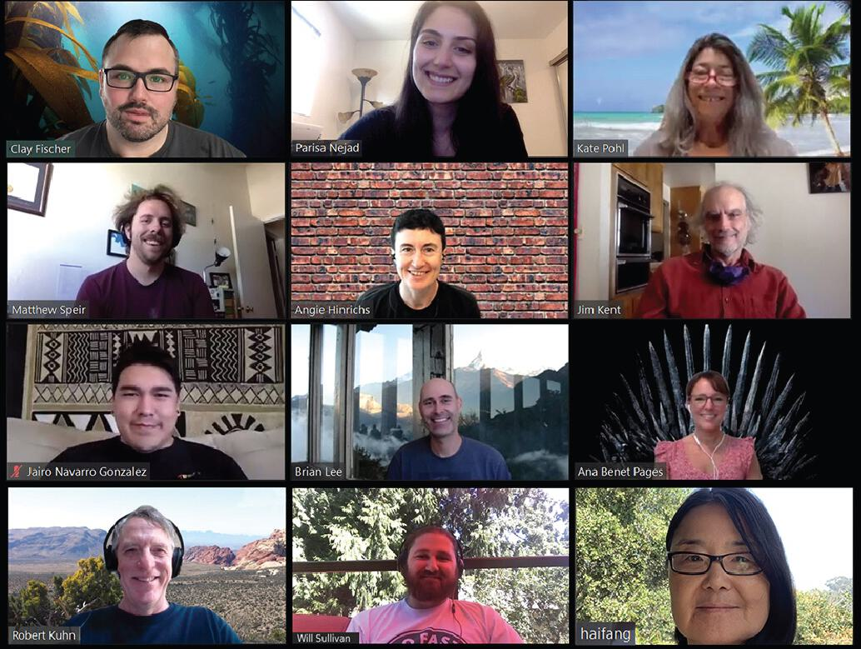
The UCSC Genome Browser Staff
Notes:
The UCSC browser staff during 2021. There have been some retirements and staff reductions since then.

Slide 3
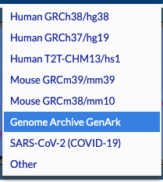
UCSC Genome Browser ‘home’ page
https://genome.ucsc.edu/
Notes:
U.C. Santa Cruz genome browser home page: https://genome.ucsc.edu/ - access the GenArk index pages via the pull-down menu ‘Genomes’ then ‘Genome Archive GenArk’

Slide 4
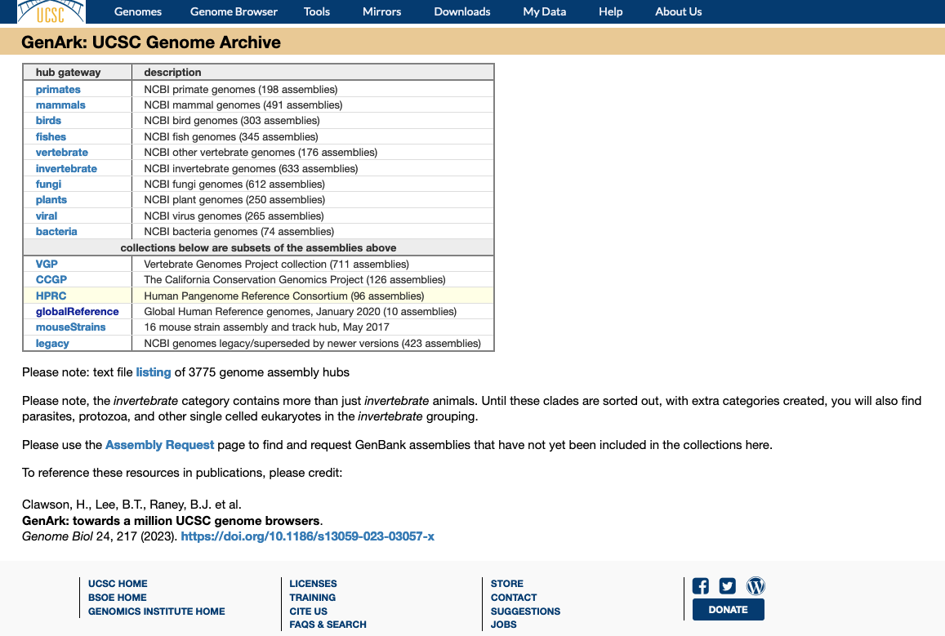
GenArk collection index
https://hgdownload.soe.ucsc.edu/hubs/
Select a set
of genome
assemblies
Collections of genome assemblies from NCBI resources:
‘RefSeq’ and‘GenBank’ assemblies.
Currently over 3,700 genome assemblies.
New assemblies can be requested and are usually ready to use within a week or two.
Notes:
The GenArk collection index page: https://hgdownload.soe.ucsc.edu/hubs/ - select one of the ‘clades’ to an index page for that set.

Slide 5
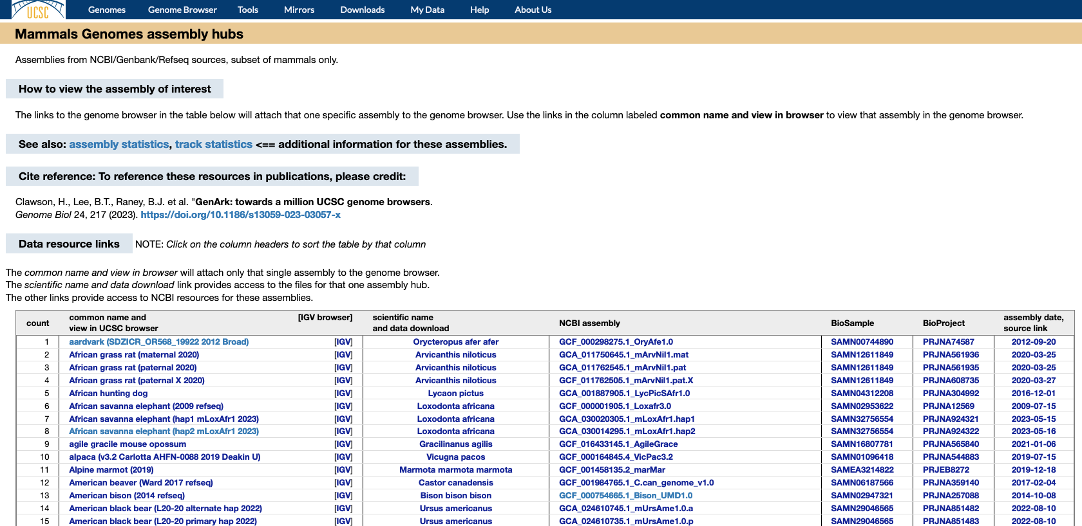
mammals index page
Each set of assemblies
has three ‘index’ pages,
with various information
about the assemblies
Notes:
Each ‘clade’ set in the GenArk has a set of three index pages. This index page, plus the ‘assembly statistics’ and ‘track statistic’ pages to explore the characteristics of the set of assemblies.

Slide 6
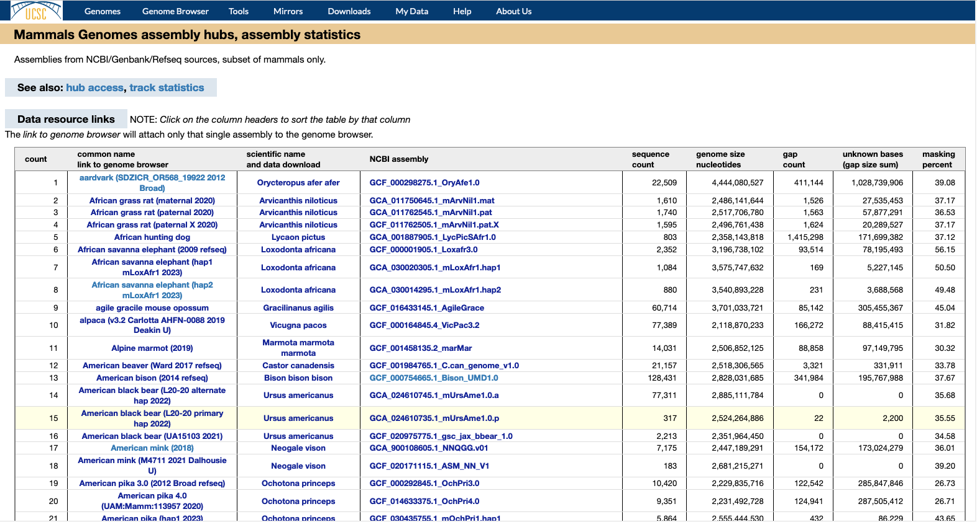
mammals ‘assembly statistics’ page
Notes:
One of the three ‘index’ pages for a set of genomes in the GenArk collection.

Slide 7
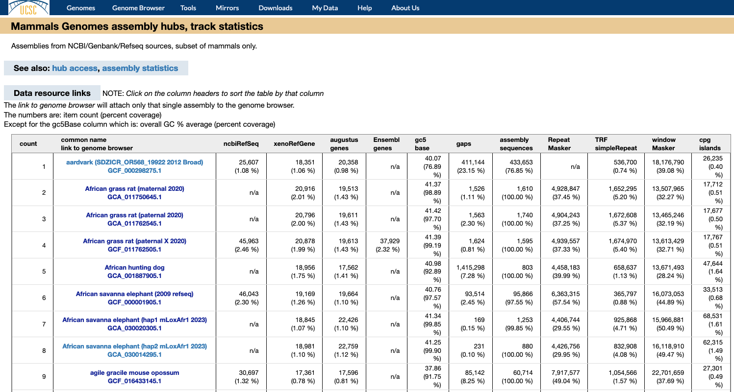
mammals ‘track statistics’ page
Notes:
One of the three ‘index’ pages for a set of genomes in the GenArk collection.

Slide 8
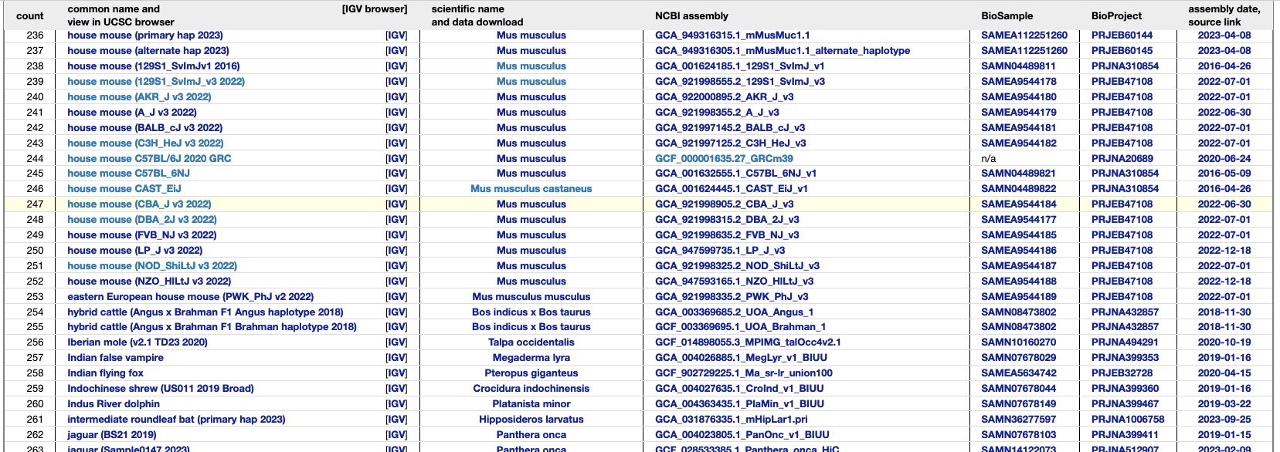
select assembly of interest
Select your genome of interest from the ‘common name’ column. This will go to the genome browser display
Notes:
On one of the GenArk index pages, click on the ‘common name’ to go to that genome browser.

Slide 9
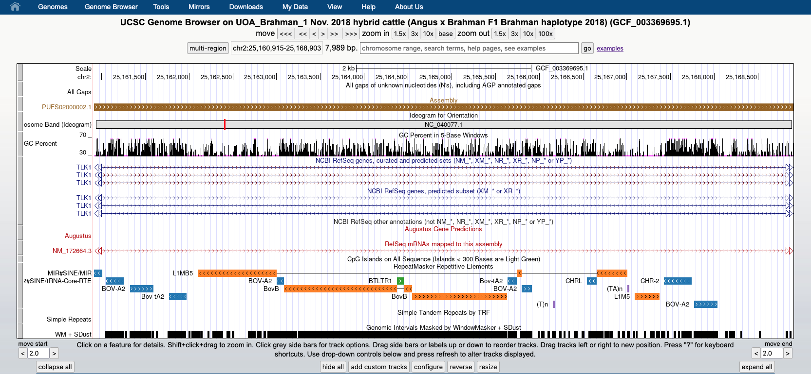
browser default set of tracks display
Notes:
U.C. Santa Cruz genome browser home page: https://genome.ucsc.edu/

Slide 10
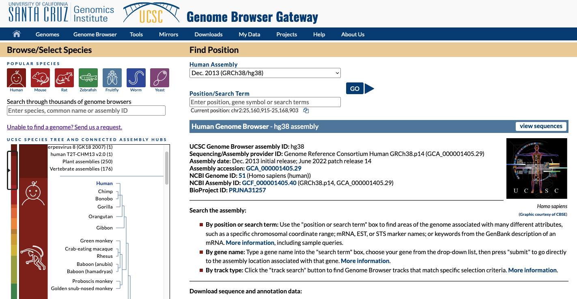
UCSC browser ‘gateway’ page
https://genome.ucsc.edu/cgi-bin/hgGateway
Alternate method to find assemblies,
use the search form on gateway page.
Notes:
A second method to find the GenArk genomes is to use the search form on the ‘gateway’ page. This search mechanism needs to be improved. It worked well when there were a few hundred assemblies, does not work well with thousands of assemblies where hundreds of assemblies can be on the same species.

Slide 11
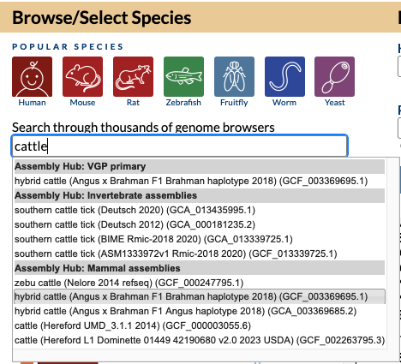
enter search term to find assembly
https://genome.ucsc.edu/cgi-bin/hgGateway
select the assembly to view from the list
Notes:
Enter a search term in the form, a pull-down menu will appear with assemblies matching your search term. Click on the assembly of interest.

Slide 12
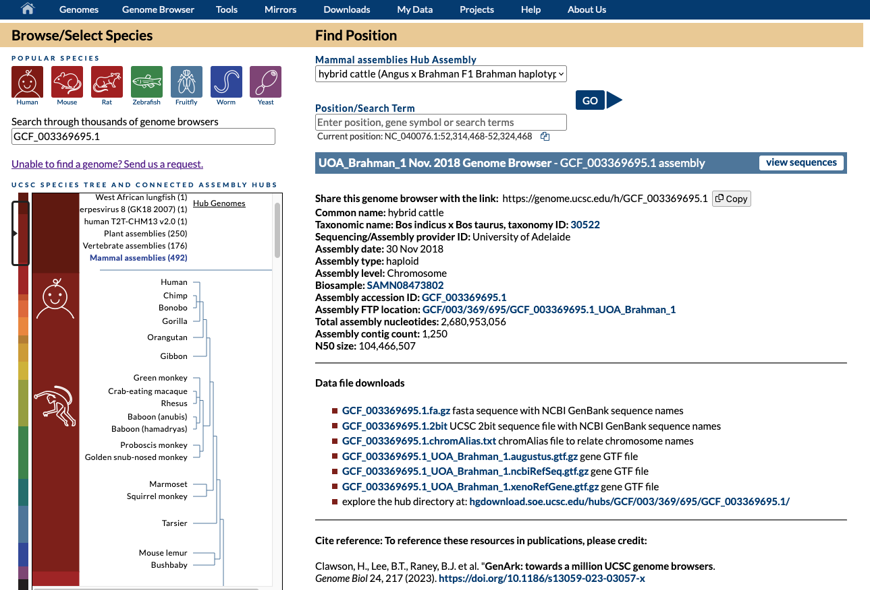
gateway page now shows your selected assembly
Notes:
After you select your assembly, it will appear on the gateway page. The ‘GO’ button goes to the genome browser display. The ‘view sequences’ button leads to a display of the names of sequences in this assembly.

Slide 13
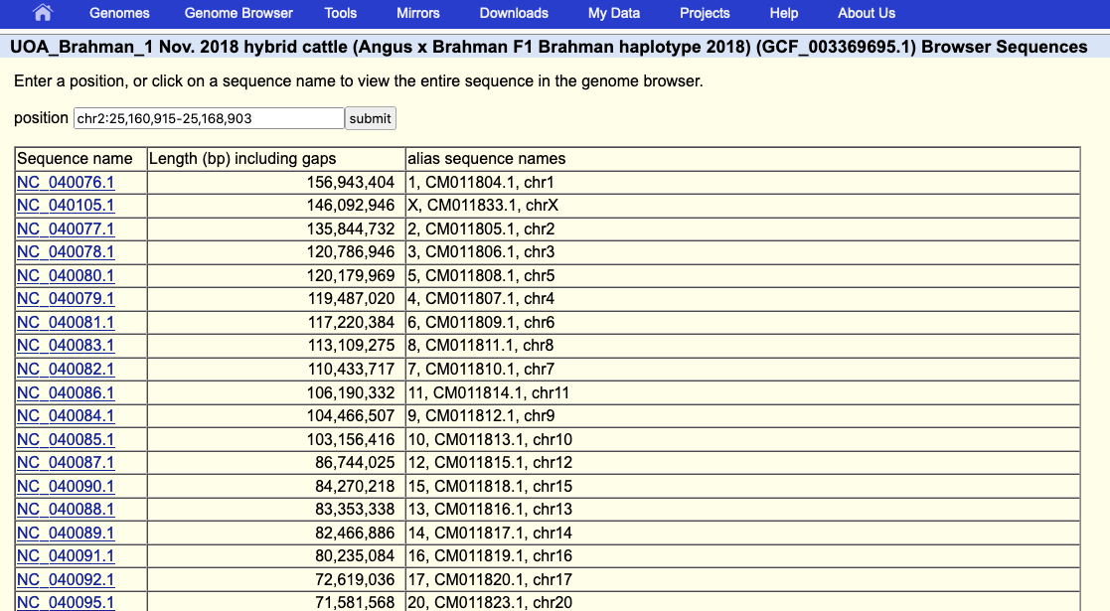
view sequences shows names and aliases
Notes:
The ‘view sequences’ shows the names of the sequences in the assembly and the alternative ‘alias’ names that can be used for custom track data display on this assembly.

Slide 14
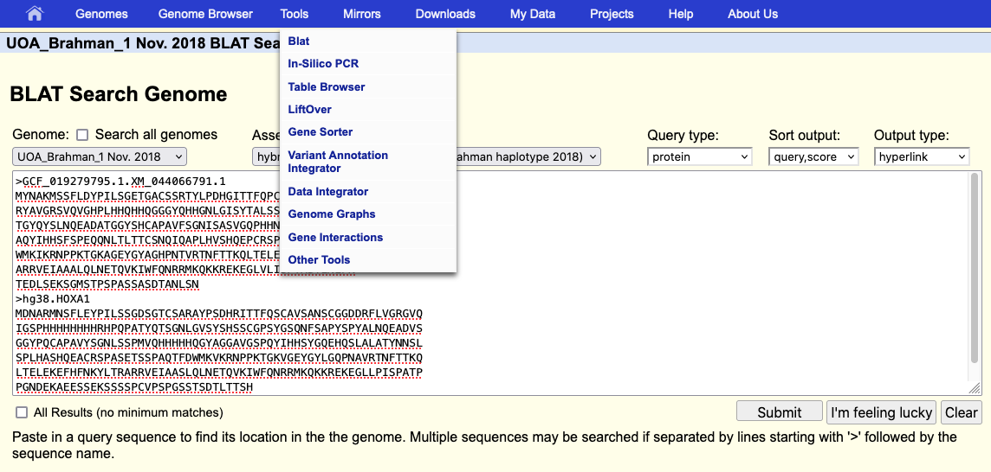
blat service now available on all assemblies
Notes:
The blat service was recently upgraded to handle very large genome assemblies. Previous limitation was a genome size of 4 Gbases.

Slide 15
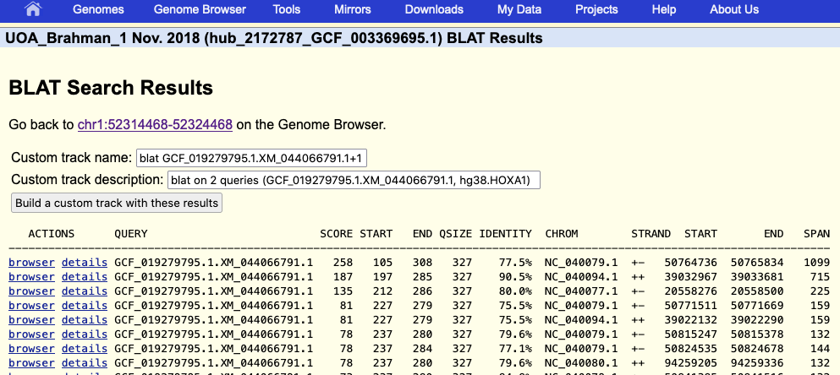
blat results
Notes:
From the blat results page, you can view the individual results, or build a custom track with all the results.

