Slide 1
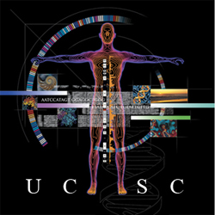

GTEx in the UCSC Genome Browser
July 2016 Update
Kate Rosenbloom
UCSC Genome Browser Group

Slide 2
Progress in 2016
GTEx gene expression track released (April)
http://genome.ucsc.edu/goldenPath/newsarch.html#042016
GTEx gene expression boxplots added to UCSC main gene track details page (May)
GTEx RNA-seq signal track hub released (June)
Above tracks/data are hosted on hg19 (GRCh37) and hg38 (GRCh38) genome browsers. Track data is GTEx V6.

Slide 3
GTEx Gene Expression track
200 Kbp region of chromosome 17, with 11 gene loci. The GTEx track displays differing patterns of tissue-specific expression across loci.
Mouseover on bars shows tissue type and median score. Click-through shows boxplot with score ranges.

Slide 4
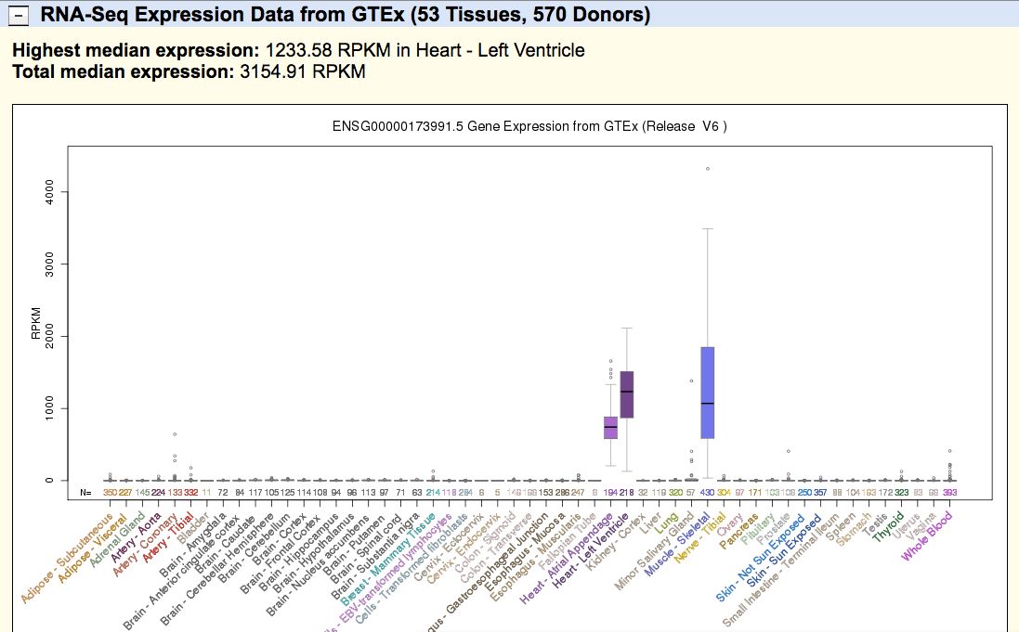
New RNA-Seq Expression section of gene details page shows boxplot of median expression levels
s

Slide 5
GTEx Signal Track Hub
* Initiated by user requests, and made possible by a new pipeline framework proof-of-concept project:
  Vivian et al. Rapid and efficient analysis of 20,000 RNA-seq samples with Toil
  http://biorxiv.org/content/early/2016/07/07/062497
    * Sequence reads from GTEx V6 were aligned to the hg38/GRCh38 genome assembly using STAR2 + GENCODE v24 transcriptome, with the –outWig option to generate read coverage signal graphs. Files were coordinate-converted to hg19/GRCh37 using the UCSC liftOver tool.
    * A total of 7572 tracks, representing samples from 570 donors are included in the track hub.

Slide 6
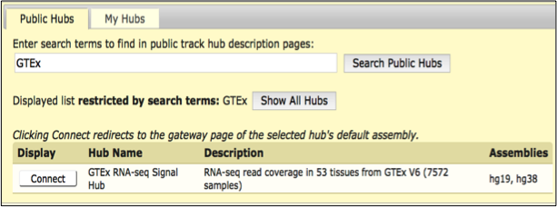
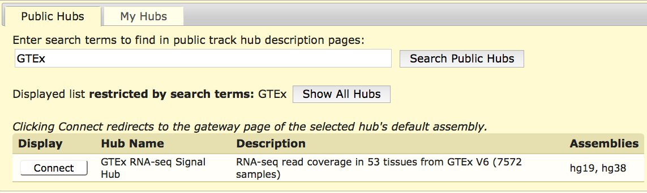
Connecting to the GTEx RNA-seq signal hub

Slide 7
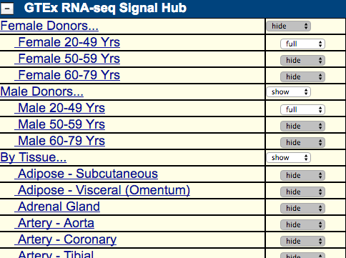
GTEx Signal Hub track organization
And 47 more…

Slide 8
24 tracks from GTEx RNA-seq signal hub (in 2 display modes) in a genomic region with 3 genes

Slide 9
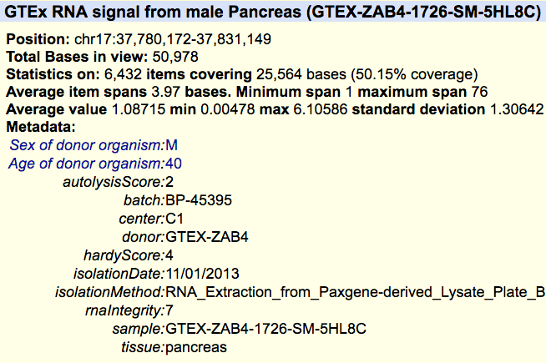
Details page for signal track

Slide 10

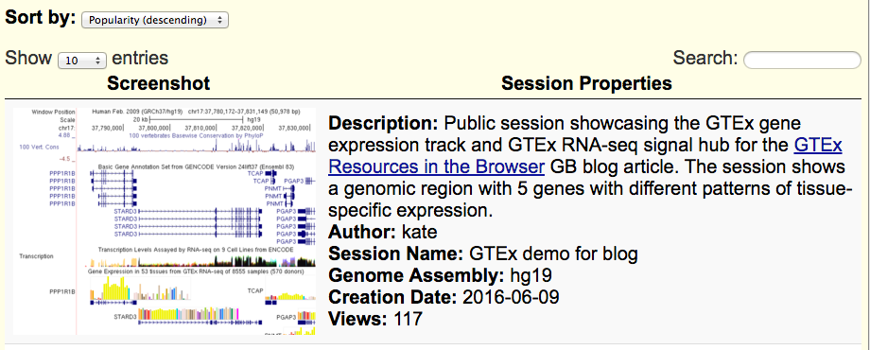
Outreach
In addition to the usual Genome Browser announcements and news section, a recent blog post was written to publicise GTEx resources at UCSC. The post included a public session – currently the most accessed session on the new Public Sessions page.

Slide 11
In Progress: ASE summary tracks
ASE sites are colored by allelic imbalance value (gray for low AE, GTEx tissue color for high AE). Both H19 and CTSD loci shown here are highly expressed, but only H19 shows marked ASE. These genes are non-adjacent on chromosome 11, viewed together here via the Genome Browser multi-region feature (red vertical bar separates the two regions).

Slide 12
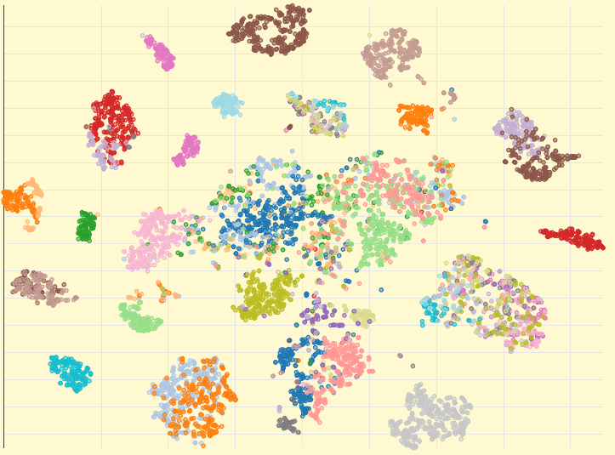
In Progress: Data summaries
Additional high-level views are being developed to expand the GTEx track description. Here, a T-SNE clustering of GTEx gene expression is colored by tissue.

Slide 13
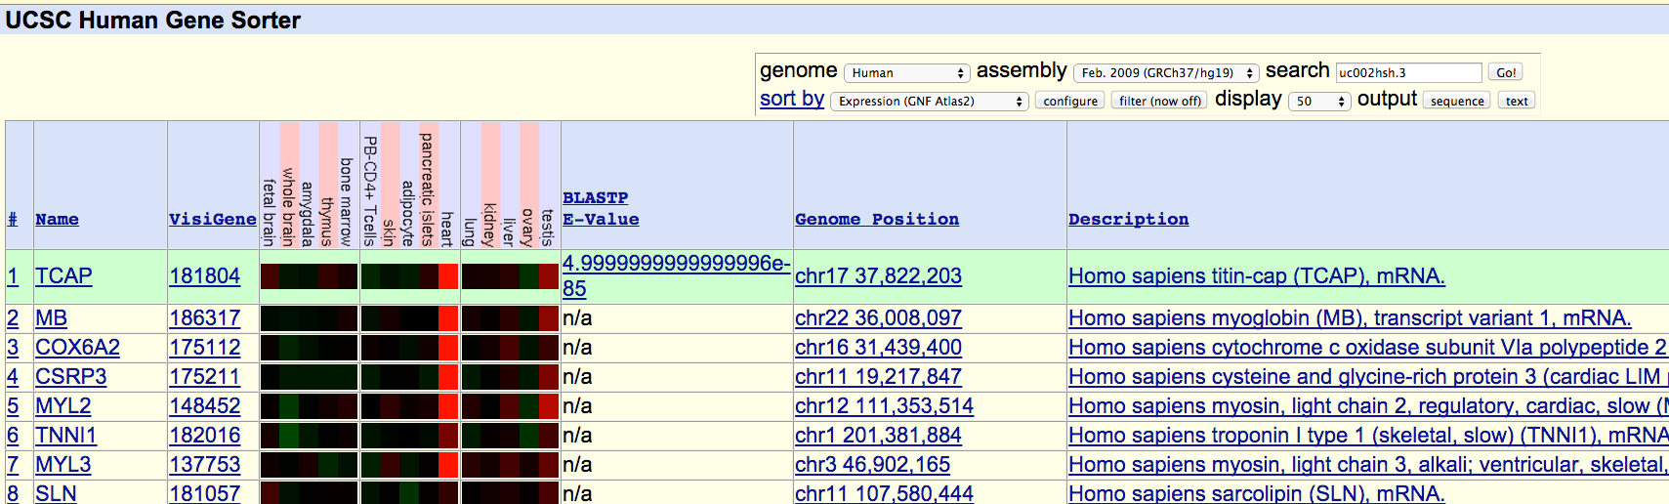
Future Plans
eQTL track
Body Map graphic for tissue selection
Integrate GTEx data into Gene Sorter tool

Slide 14
Future Plans, cont.
* Feature enhancement to GTEx gene track: comparison function to subset samples and display
Gender expression differences graph. The tissue filter was applied here to exclude
gender-specific tissues.

Slide 15
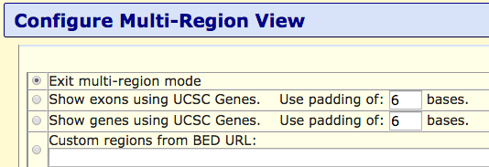
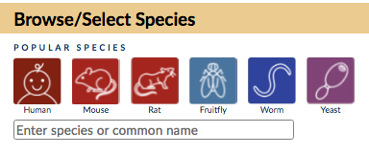
Browser News for 2016
Multi-region view: exon-only, gene-only, custom regions
CRAM file support
Density graph feature for BAM tracks
Public sessions page
Modernized home page and ‘Gateway’ page (genome selection)
Asian mirror site

Slide 16
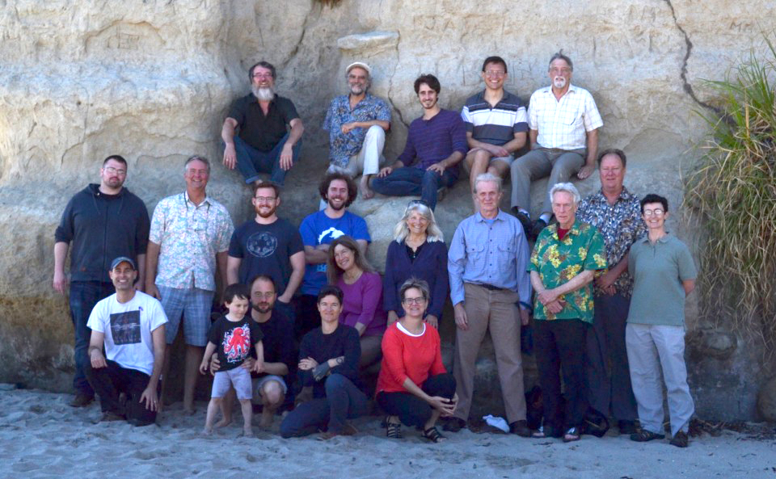
Acknowledgements
Colleagues: UCSC Genome Browser group PI: Jim Kent
Chris Lee and Parisa Nejad (UCSC QA team) reviewed and released the GTEx tracks.
John Vivian, Melissa Cline, and Benedict Paten (UCSC CGL lab) were responsible for the
RNA-seq recompute and signal generation for the GTEx signal hub.
Collaborators: GTEx LDACC, Consortium and Analysis Group
Stephane Castel and Tuuli Lappalainen (of NY Genome Ctr) provided design guidance
and data for ASE tracks.
Tim Sullivan (Broad Inst) and Anna Vlasova (CRG, Barcelona) instigated and provided
guidance and review of the GTEx signal hub.
Funding: NHGRI (5 U41 HG002371-16 to UCSC Center for Genomic Science)

Slide 17


UCSC Browser Help
Send us a message to our public mailing list:
genome@soe.ucsc.edu
View training info, videos, and user’s guides:
http://genome.ucsc.edu/training/
Find us on: Genome Browser
@GenomeBrowser
UCSC Genome Browser
More information:
Send us a message on our public mailing list:
genome@soe.ucsc.edu
View training info, videos, and user’s guides:
http://genome.ucsc.edu/training/
Find us on:
GenomeBrowser
@GenomeBrowser
UCSC Genome Browser
More information:
Send us a message on our public mailing list:
genome@soe.ucsc.edu
View training info, videos, and user’s guides:
http://genome.ucsc.edu/training/
Find us on:
GenomeBrowser
@GenomeBrowser
UCSC Genome Browser
More information:
Send us a message on our public mailing list:
genome@soe.ucsc.edu
View training info, videos, and user’s guides:
http://genome.ucsc.edu/training/
Find us on:
GenomeBrowser
@GenomeBrowser
UCSC Genome Browser

