Slide 1
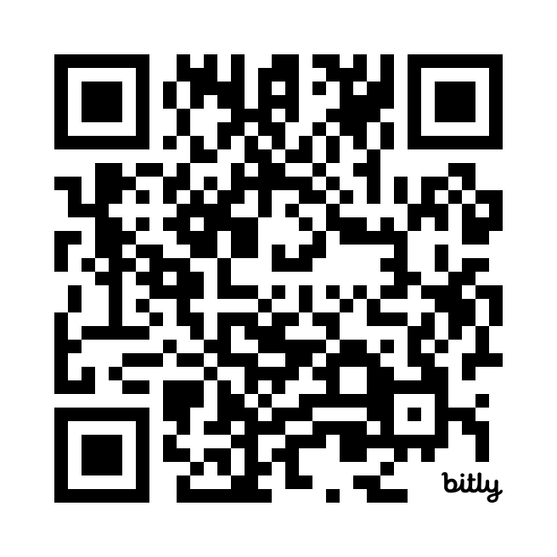
Thursday, 03 April 2025
RIKEN Yokahama
Hiram Clawson – U.C. Santa Cruz Genomics Institute
hclawson@ucsc.edu
Recent updates in the
UCSC Genome Browser
Our work is supported by a number of different grants:
National Human Genome Research Institute U24HG002371
National Institute of Mental Health RF1MH132662
National Science Foundation 2419522 subcontract S006079-NSF
California’s Stem Cell Agency DISC0-14514
National Institute of Allergy and Infectious Diseases U24AI183870
subcontract S005829-DHHS
Copy of this presentation:
https://bit.ly/4lrY5SW
Notes:
RIKEN Yokohama, Thursday 03 April 2025 – Recent updates in the UCSC Genome Browser– Hiram Clawson – U.C. Santa Cruz Genomics Institute – latest copy of this presentation: https://bit.ly/4lrY5SW

Slide 2
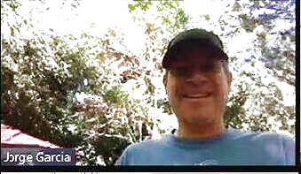
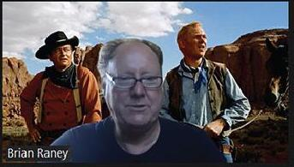
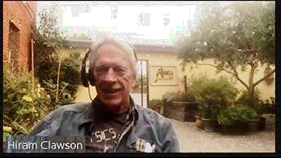
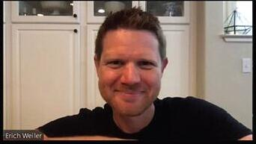
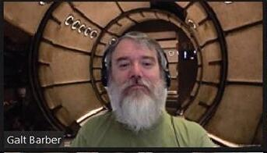
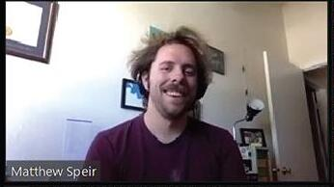
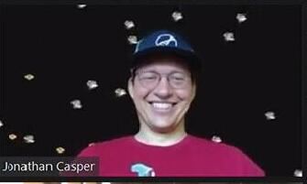
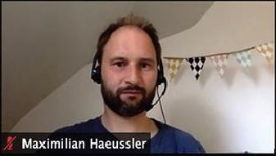
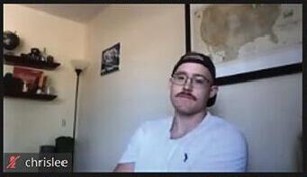
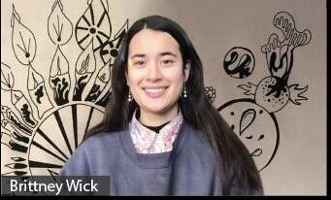
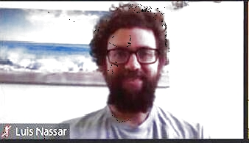
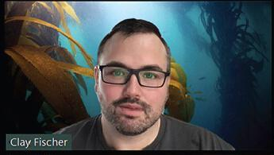
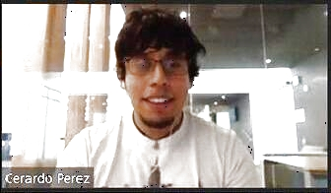
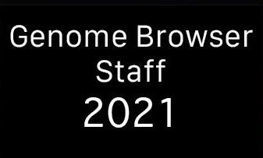
UCSC Genome Browser Staff 2025
Jorge
Angie
Brian
Hiram
Erich
Galt
Matt
Jonathan
Max
Chris
Brittney
Lou
Jairo
Clay
Gerardo
2025
Notes:
The UCSC browser staff 2025.

Slide 3
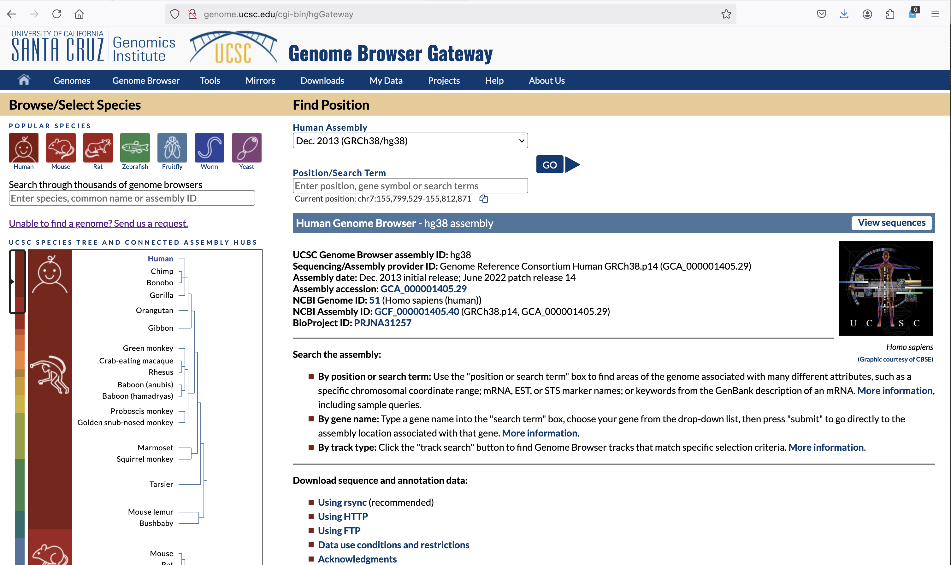
UCSC Genome Browser ‘gateway’ page
Note the search
form entry
Text search, any
word, case
insensitive
https://genome.ucsc.edu/cgi-bin/hgGateway
Notes:
Here on the ‘gateway’ page, note the search box prompt: “Enter species, common name or assembly ID” – it is essentially a text search for any word. Implemented as a MySQL full text search.

Slide 4
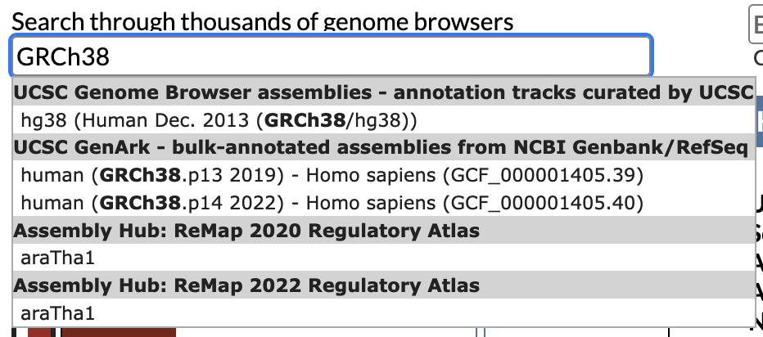
Single word search
For example, an assembly name
Click on item to display in browser
Unique words: few match results
Notes:
Single words when matched exactly

Slide 5
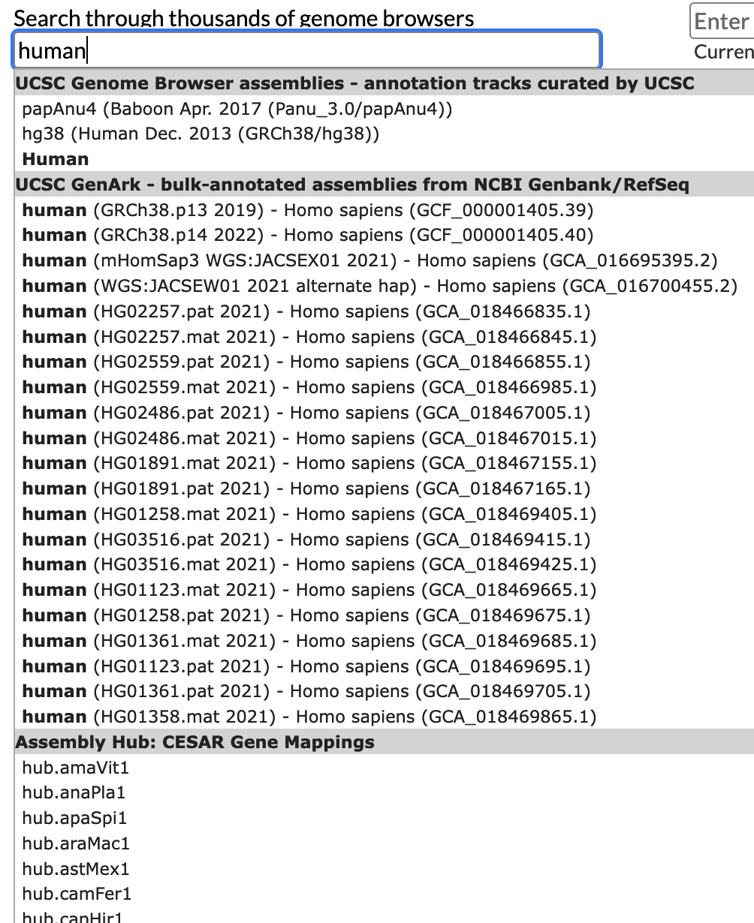
Common words, limited number results e.g.: ‘human’
Browsers with annotated tracks, curated by UCSC
Automated annotations on NCBI GenBank/RefSeq
There is an ordering to the results,
the ‘important’
assemblies should be first.
External assembly hubs from third party contributors
Notes:
Common words could have a large number of matches, the display will be a limited number from the full match set. The implicit ordering should show the more ‘important’ assemblies first.

Slide 6
What do I mean by ‘important’ assemblies ?
Search results are ordered by the following rules:
GRCh38 - human
GRCm39 – mouse
T2T CHM13v2/hs1 – human
UCSC annotated primate assemblies
Automated annotation (GenArk) human assemblies
Automated annotation (GenArk) primate assemblies
UCSC annotated mammal assemblies
Automated annotation (GenArk) mammal assemblies
All other UCSC annotated assemblies
All other automated annotation (GenArk) assemblies
‘GenArk’ assemblies: https://hgdownload.soe.ucsc.edu/hubs/
Notes:
There is an order to the search results targeted at our primary audience. Note the automated assemblies available at: https://hgdownload.soe.ucsc.edu/hubs/

Slide 7
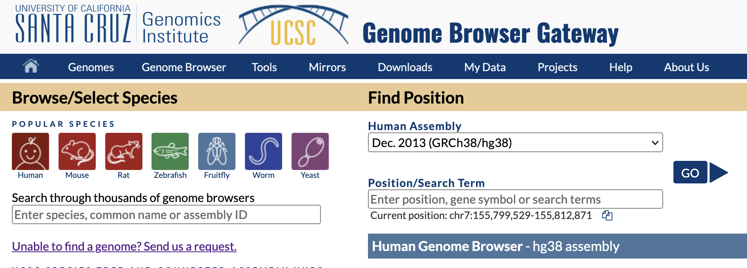
What are ‘UCSC annotated’ vs. ‘automated annotated’ assemblies
The ‘UCSC annotated’ assemblies are the classic reference assemblies such as GRCh38/hg38, and GRCm39/mm39 with literally thousands of annotated tracks from research projects. UCSC solicits and accepts such annotations from research projects and ensures the data has acceptable quality and documentation to make the annotations useful to the community.
Typically, one of these assemblies:
‘Automated annotated’ assemblies – almost completely generated by existing procedures such as repeat masking, ‘Augustus’ gene finding, GC percent, CpG islands a fixed set of fundamental tracks. Found in the ‘GenArk’ collection: https://hgdownload.soe.ucsc.edu/hubs/
Notes:
UCSC ‘annotated’ are the standard reference assemblies for ‘model’ species. The ‘GenArk’ collection are automated builds with a fixed set of standard tracks.

Slide 8
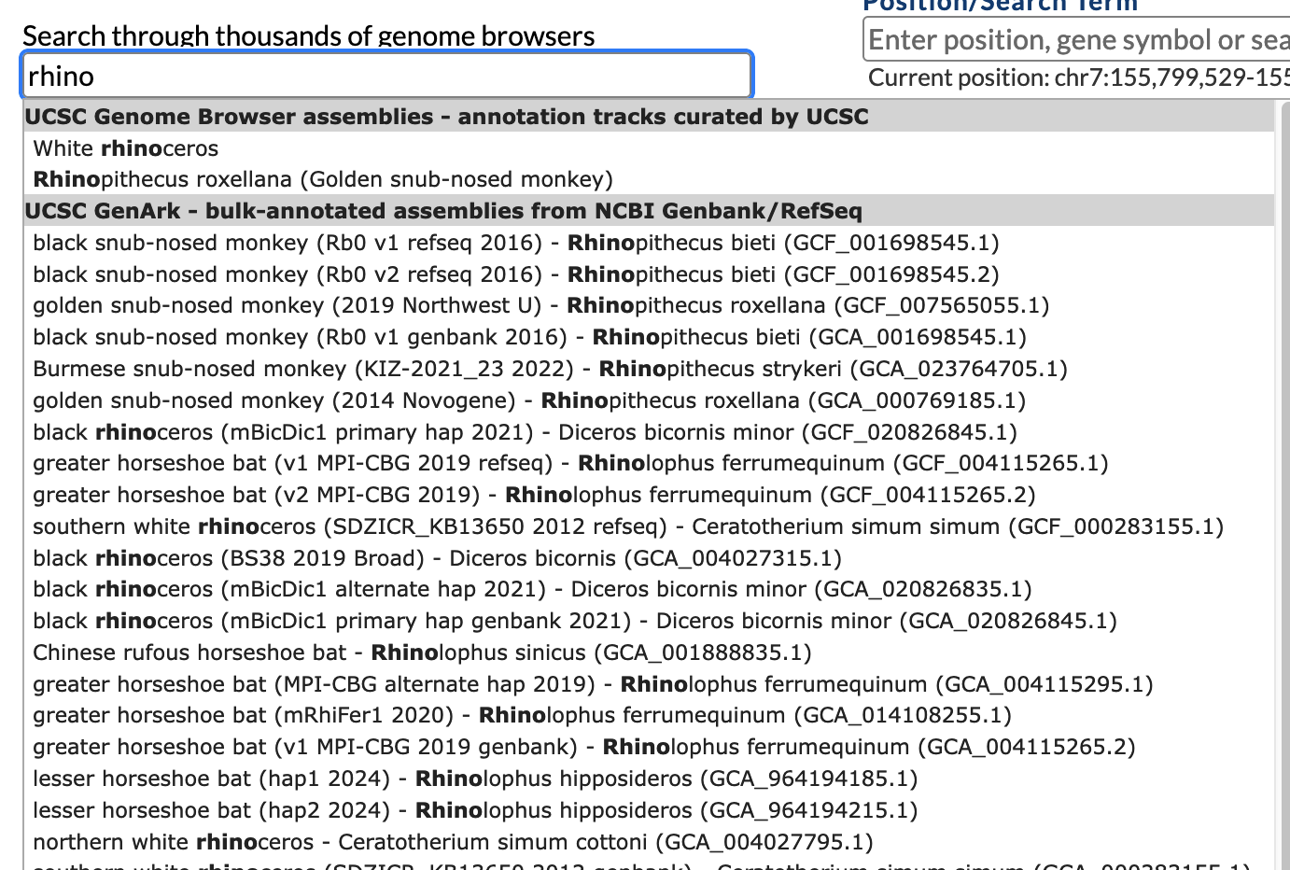
Single word search can be a prefix match
When word does not match exactly to a word, it automatically becomes a prefix search.
Notes:
A single word search will match as a ‘prefix’ to words when it is not found as an exact match to a word.

Slide 9
Multiple word search can be revealing:
Add the * to the word: ‘rhino*’ to force it to be a prefix match.
All the words must have a match in the item to be in the results.
Add minus (-) before a word to exclude it from the match:
Notes:
Multiple word searches have a number of hidden features that can be used to improve the search result. Will see the documentation on the hidden features here later.

Slide 10
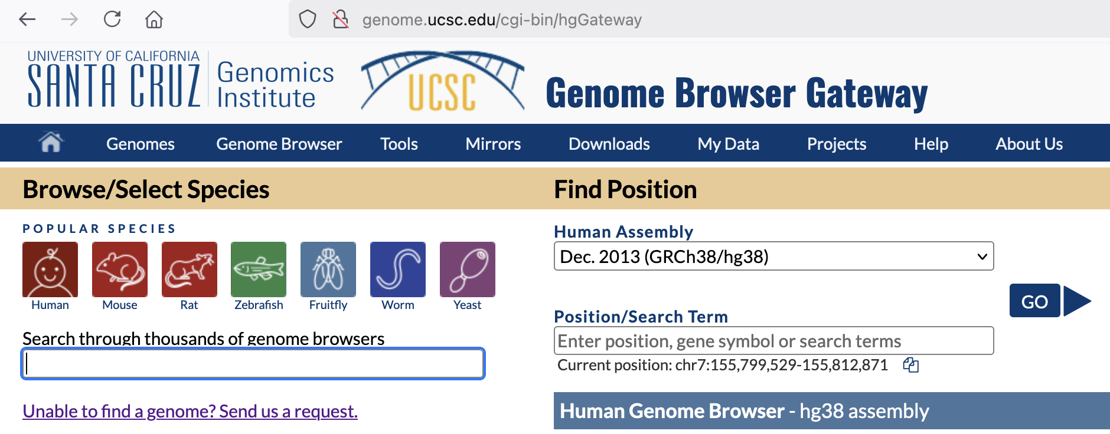
Maybe what you want is not yet in the UCSC browser.
https://genome.ucsc.edu/assemblySearch.html
Notes:
When your search in the gateway page is not finding something related, use the link to go to the more general assembly search page.

Slide 11
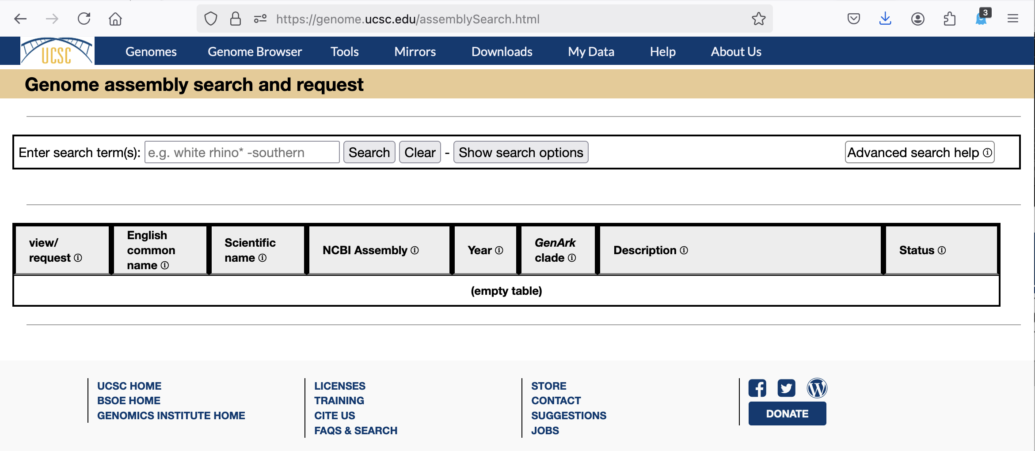
A more general search service
Search option controls
https://genome.ucsc.edu/assemblySearch.html
Notes:
The search service with more options than the gateway page search.

Slide 12
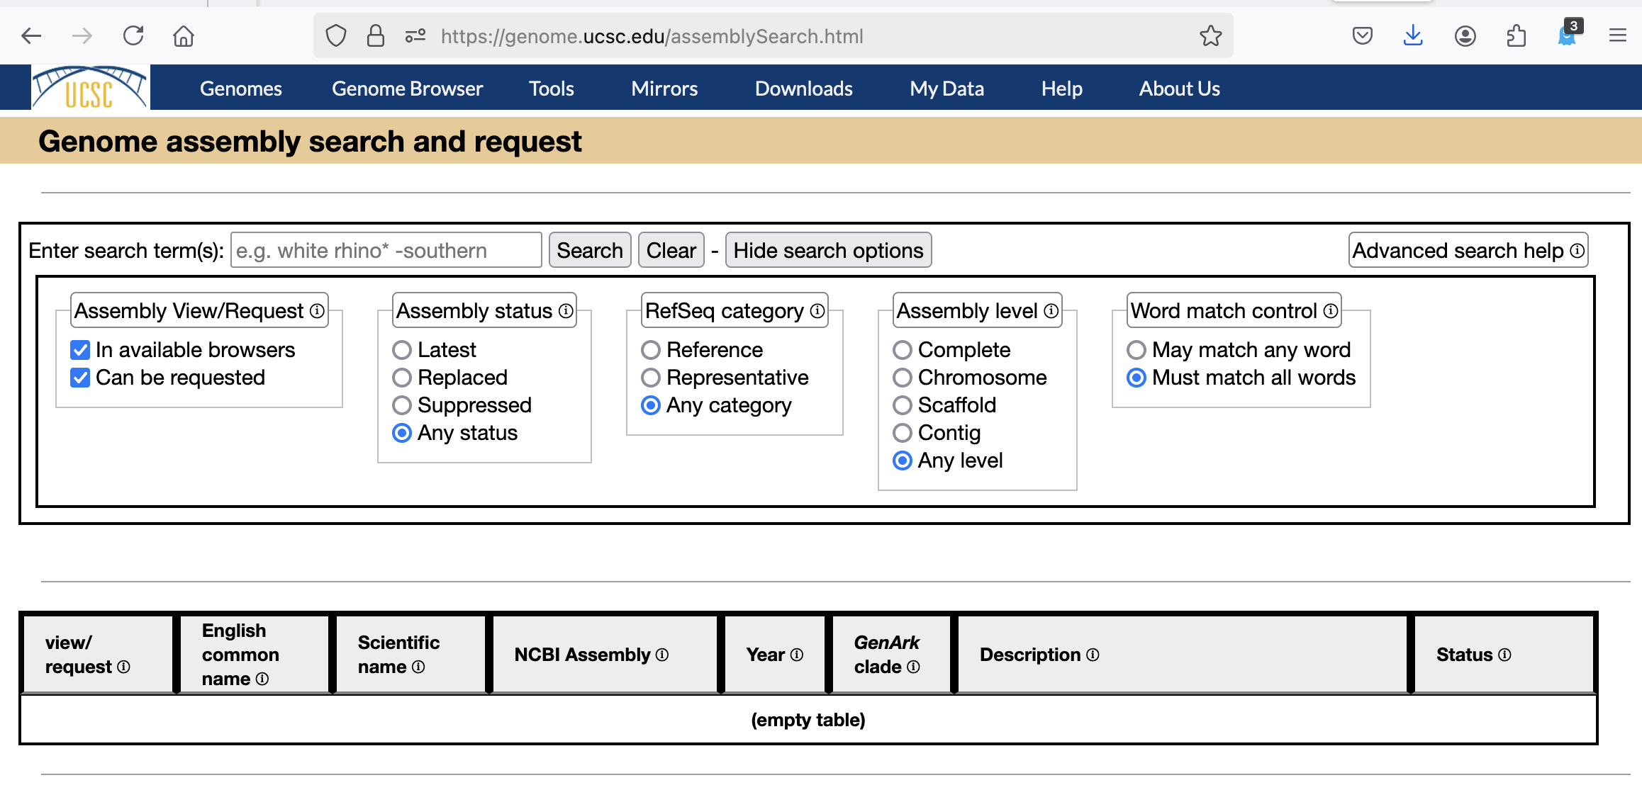
A more general search service
Search option controls
https://genome.ucsc.edu/assemblySearch.html
Notes:
Show/Hide search options

Slide 13
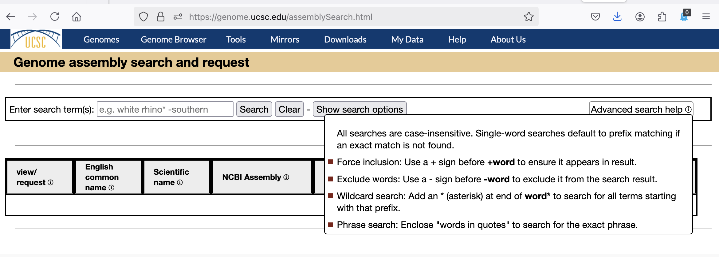
A more general search service
Hover for help text
https://genome.ucsc.edu/assemblySearch.html
Notes:
Hover over “Advanced search help” for help text. These are the ‘hidden’ features of the multiple word search on the gateway page.

Slide 14
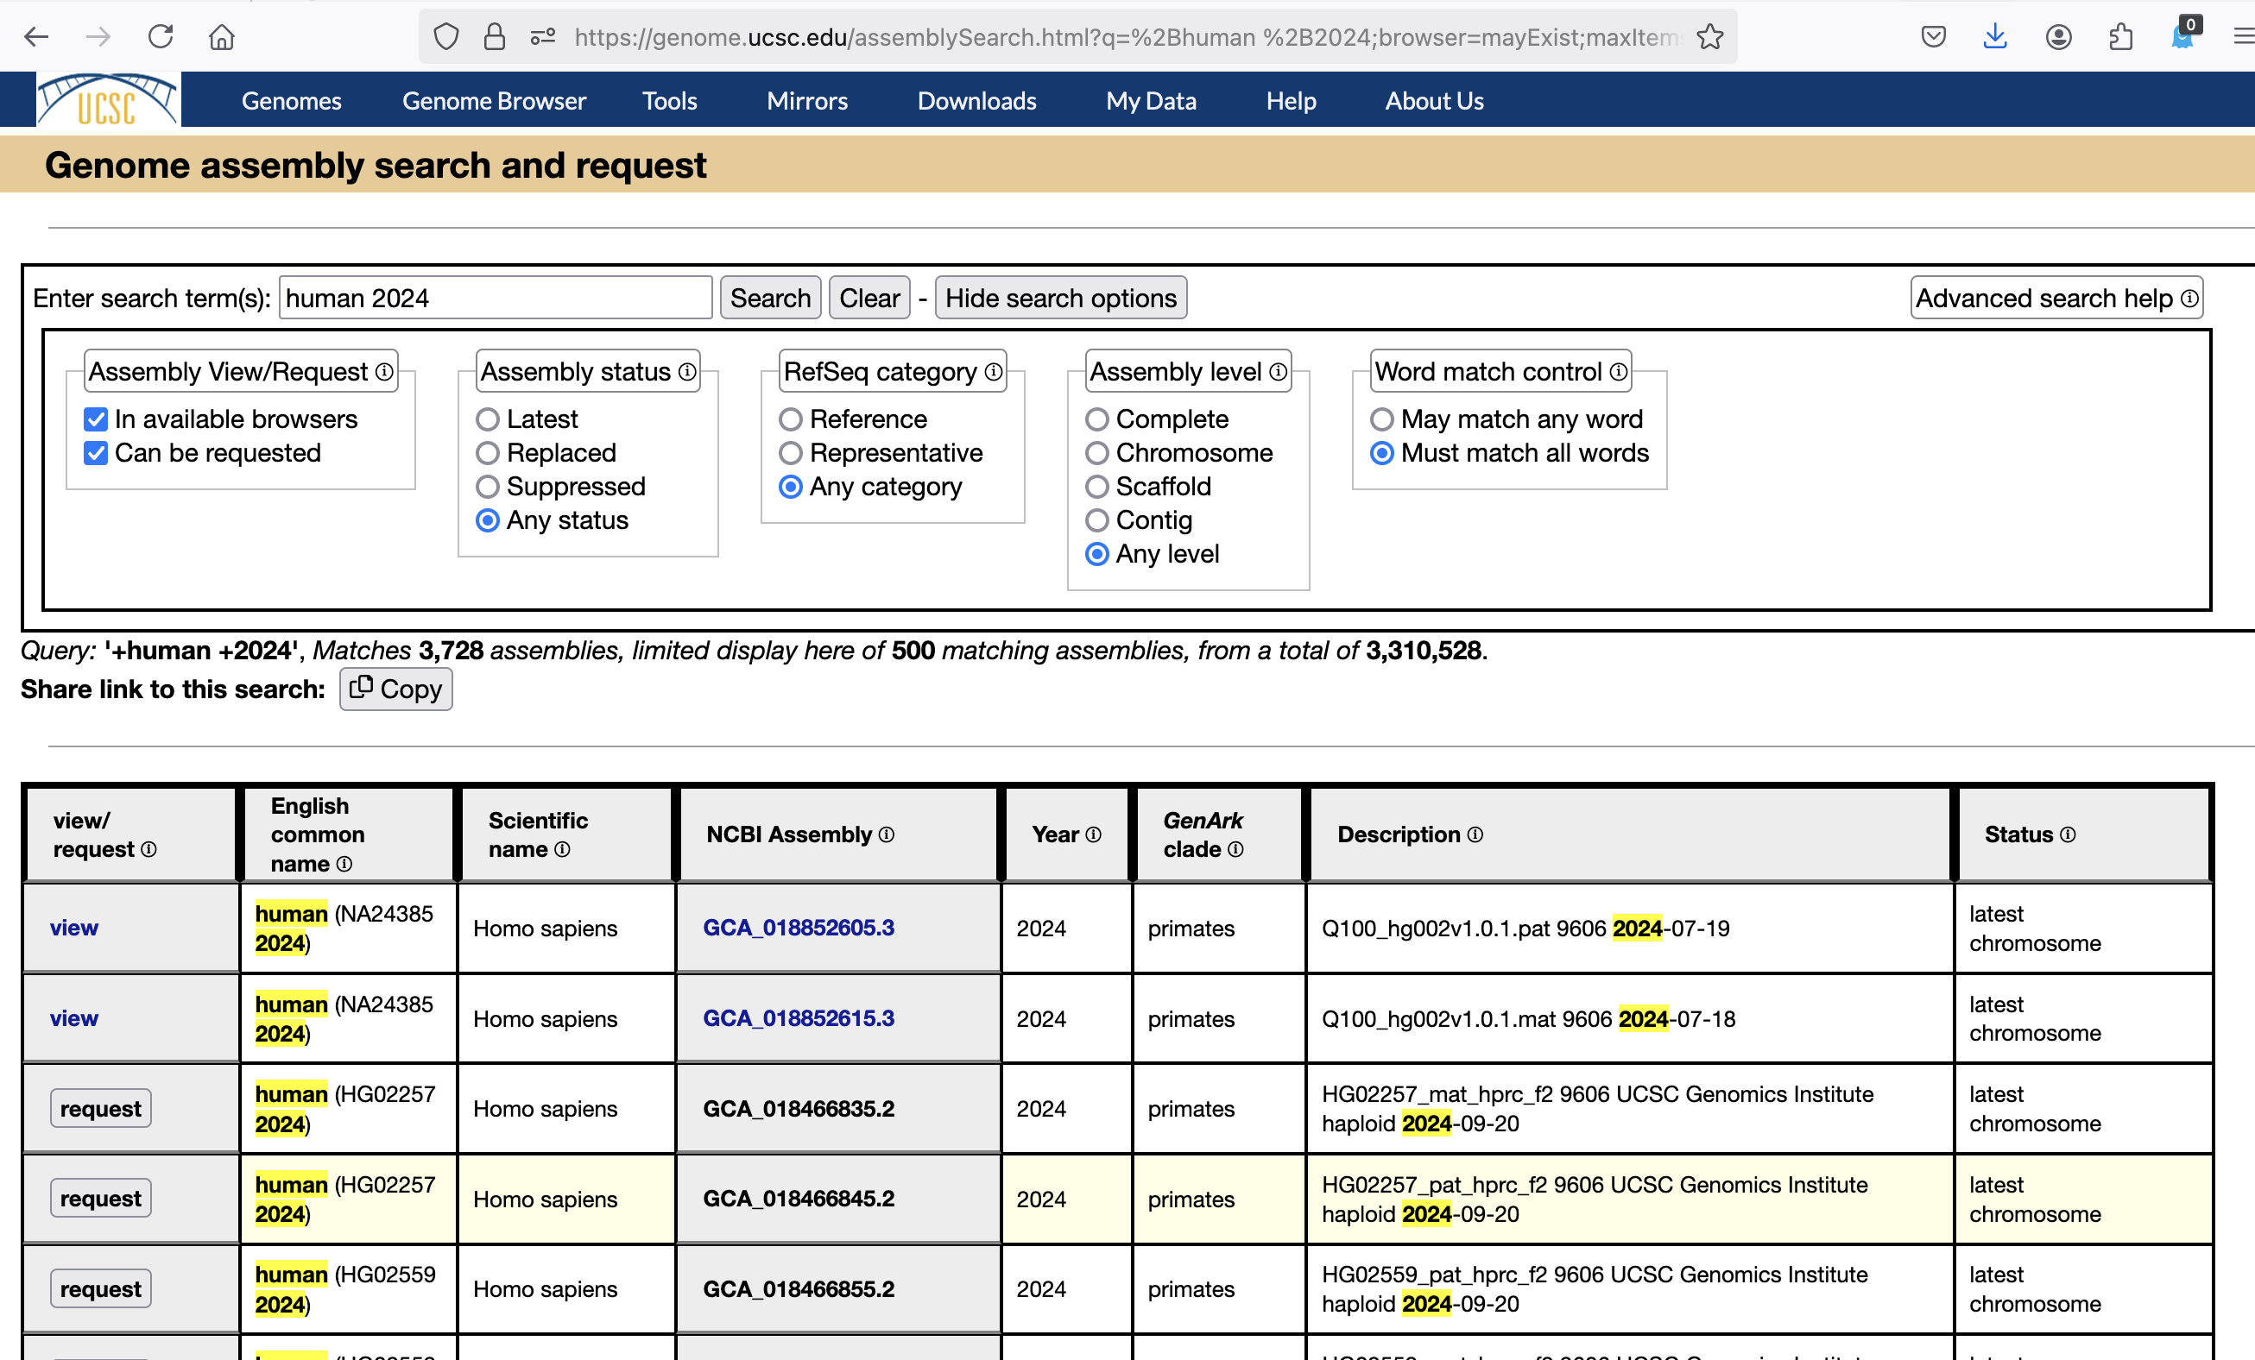
+human +2024
‘view’ in browser
‘request’ add to browser
https://genome.ucsc.edu/assemblySearch.html
Notes:
This search service can show assemblies already in the browser, or provide a request form for assemblies not yet in the browser.

Slide 15
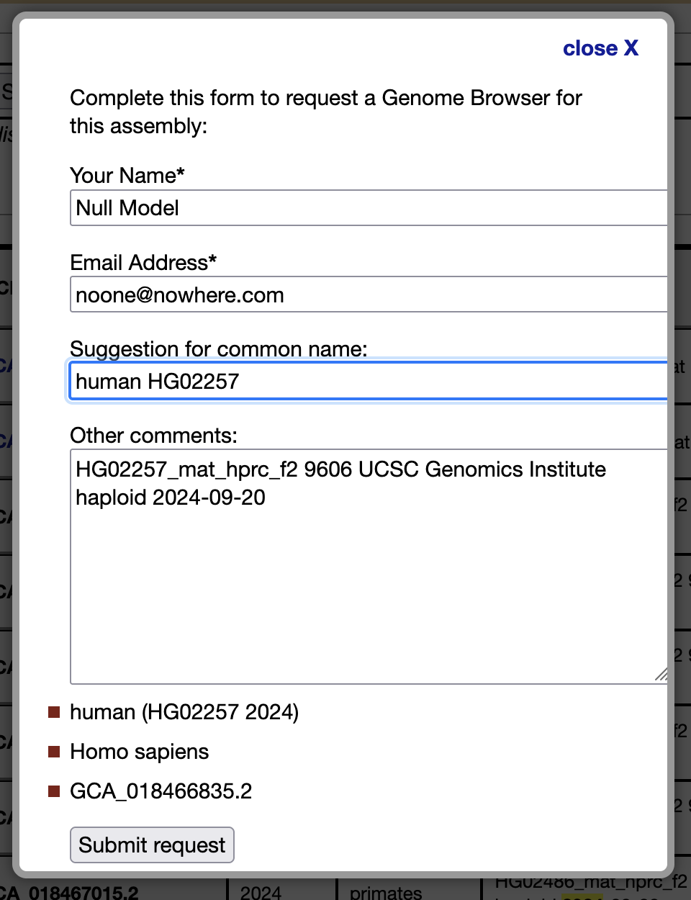
Submit request for assembly addition to the browser
Enter your email for our contact back to you for confirmation
This is only for assemblies existing in the NCBI GenBank assembly system. To submit your assembly to GenBank:
Filled in information to indicate what you have selected.
https://www.ncbi.nlm.nih.gov/genbank/genomesubmit/
AKA: https://bit.ly/3DP2MoB
Notes:
Enter your email address so we can contact you for questions about your request and respond to your request when it is complete. If you know of a good common name for this organism, let us know. To submit your assembly to GenBank: https://www.ncbi.nlm.nih.gov/genbank/genomesubmit/

Slide 16
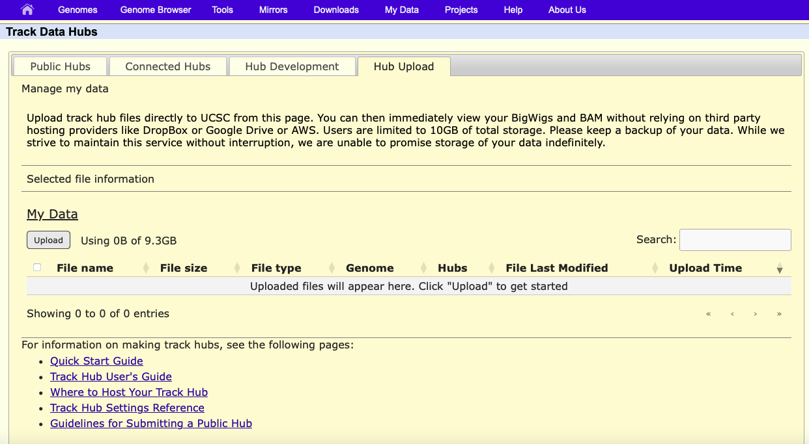
Hub Upload – under development
https://genome-test.gi.ucsc.edu/cgi-bin/hgHubConnect
Data storage service on our servers for user’s track hub data.
Use only temporary test data on this test site at this time.
Notes:
This is a service under development about ready to be released. Experiments with it now will not be permanent, this is a test environment.

Slide 17
And many other features not mentioned today
https://www.genome.ucsc.edu/goldenPath/newsarch.html
Many new hg38 tracks
Two interactive tutorials
Download track data feature
More API endpoints
Hubs can define groups
HPRC data
Decorators
Improved search feature
Various trackDb statements
* IGV/Jbrowse2/Ensembl all support our track hubs
Notes:
Many new features have been developed during the past year

Slide 18
UCSC Genome Browser Staff 2025
Jorge
Angie
Brian
Hiram
Erich
Galt
Matt
Jonathan
Max
Chris
Brittney
Lou
Jairo
Clay
Gerardo
2025
Notes:
The UCSC browser staff 2025.

