Slide 1
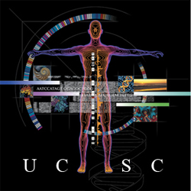
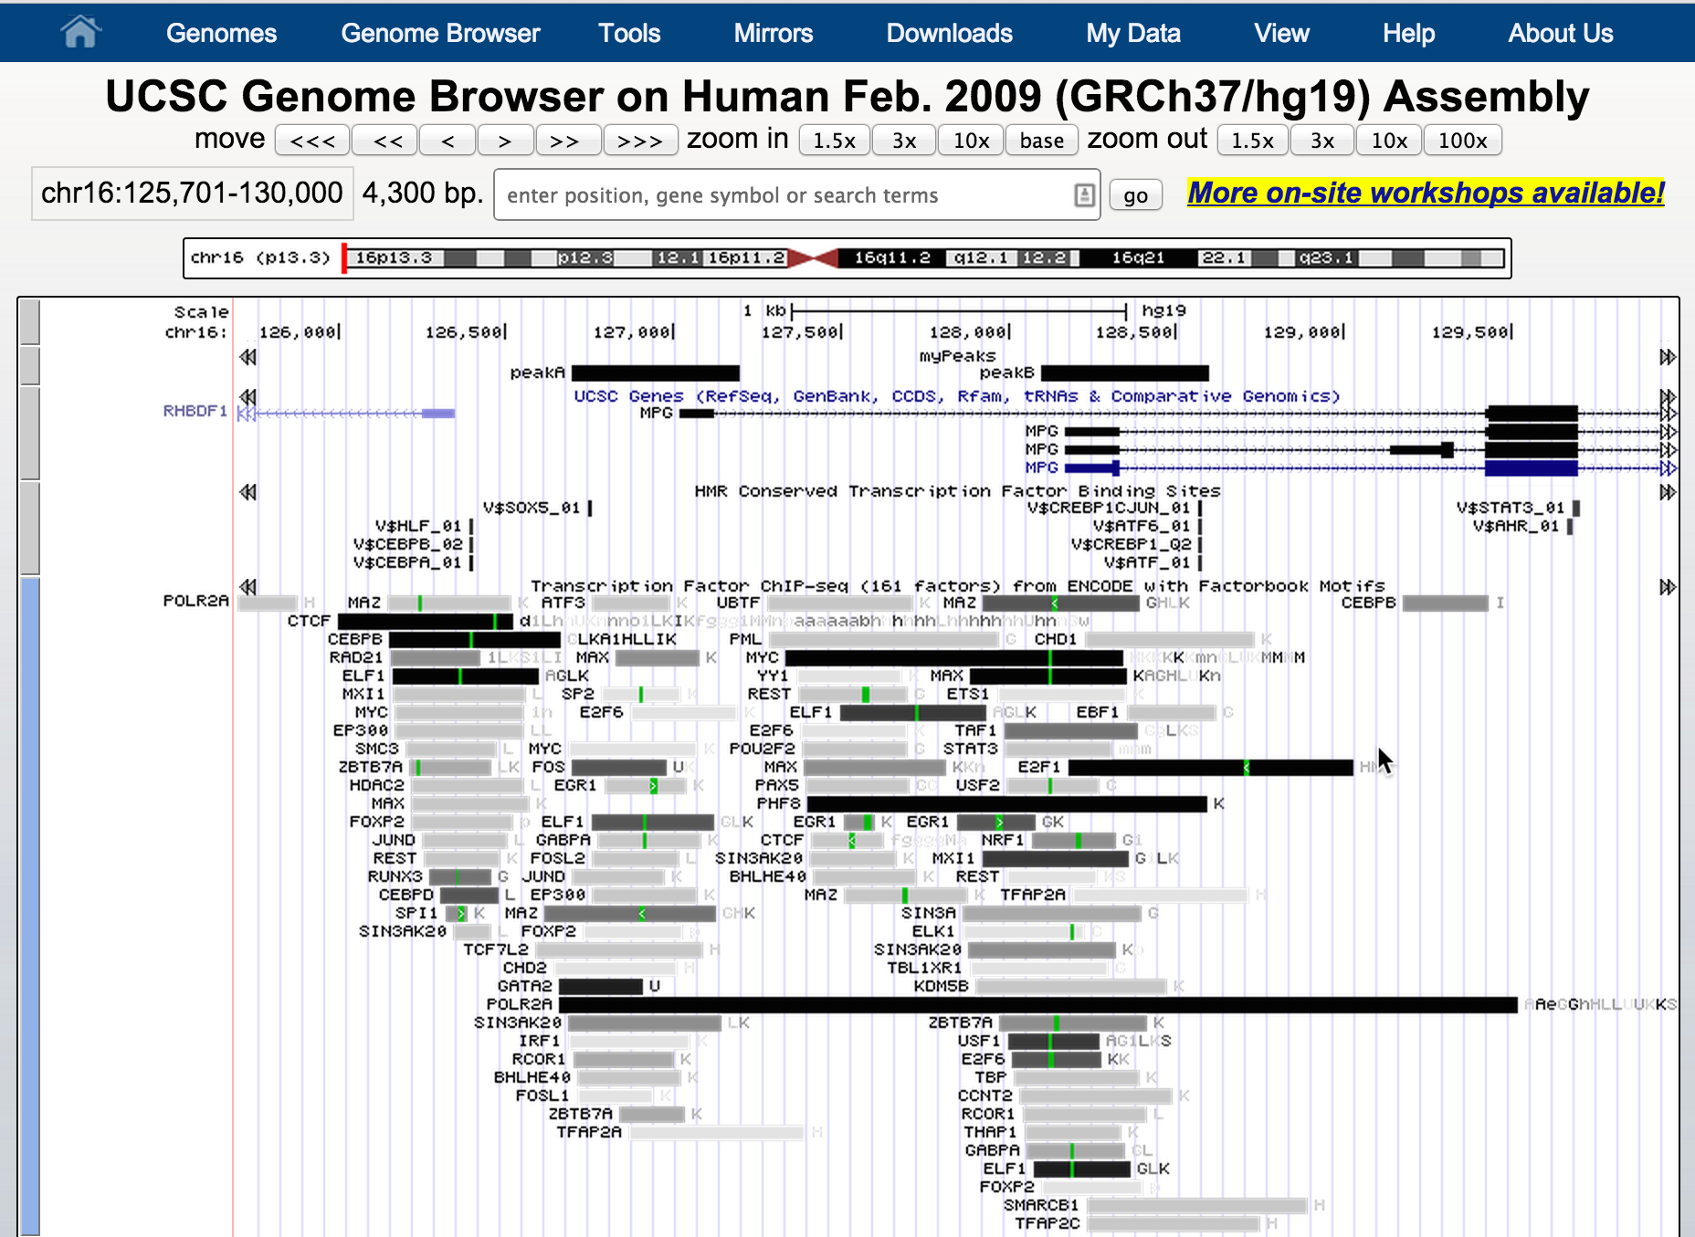
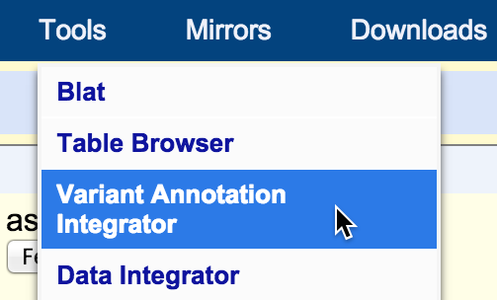
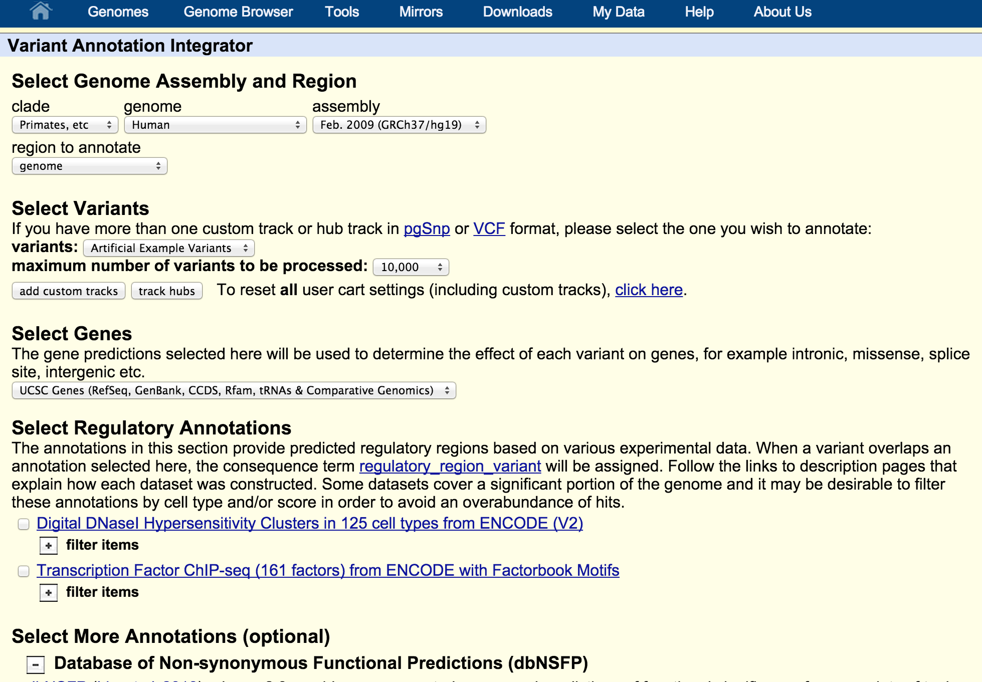
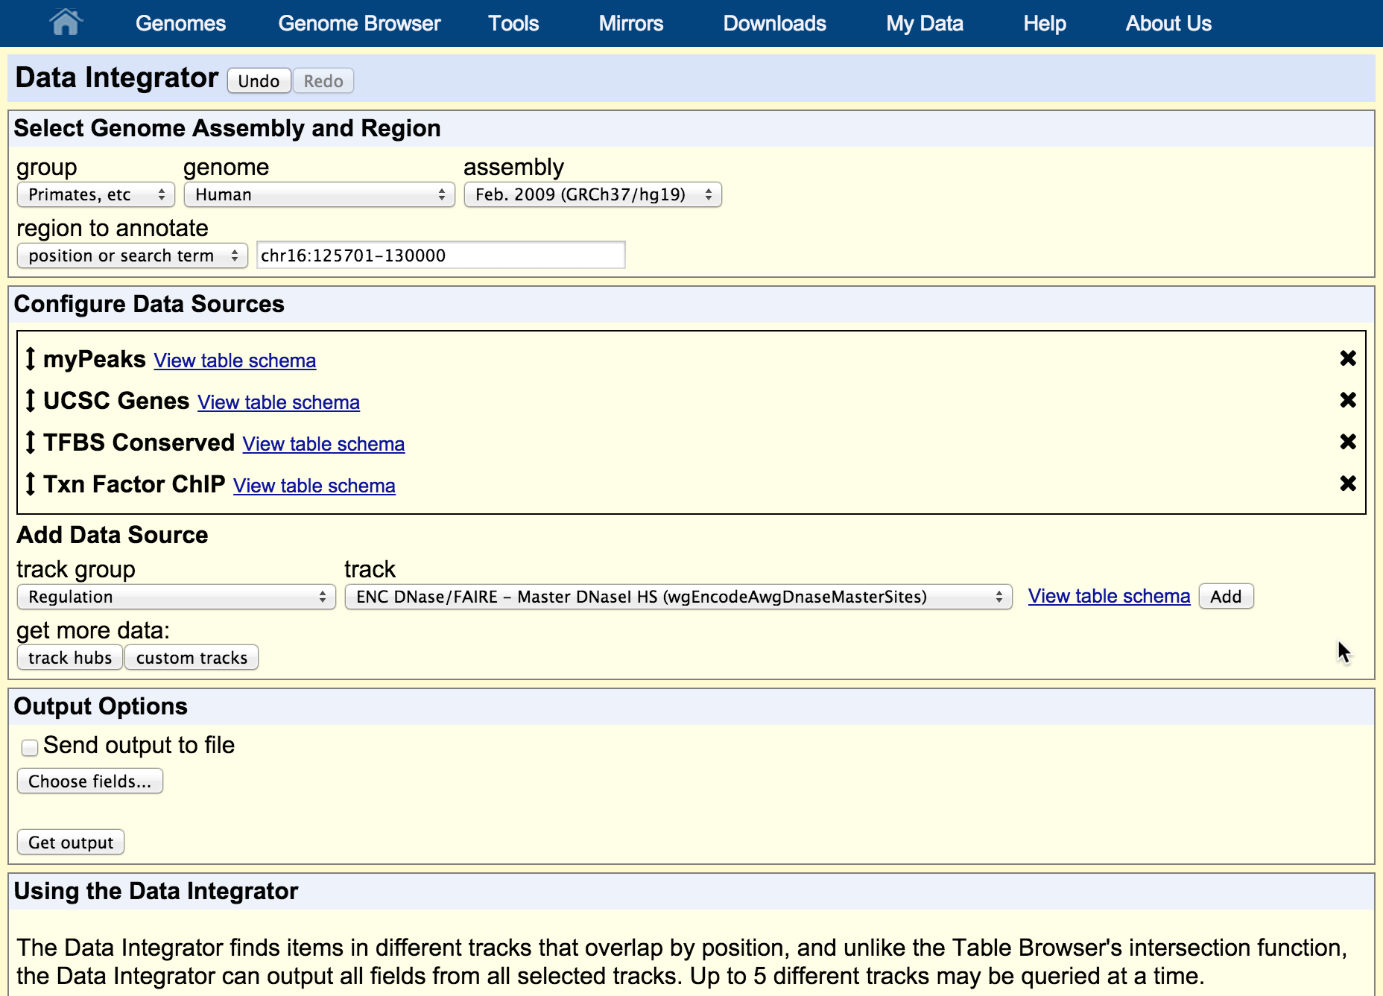
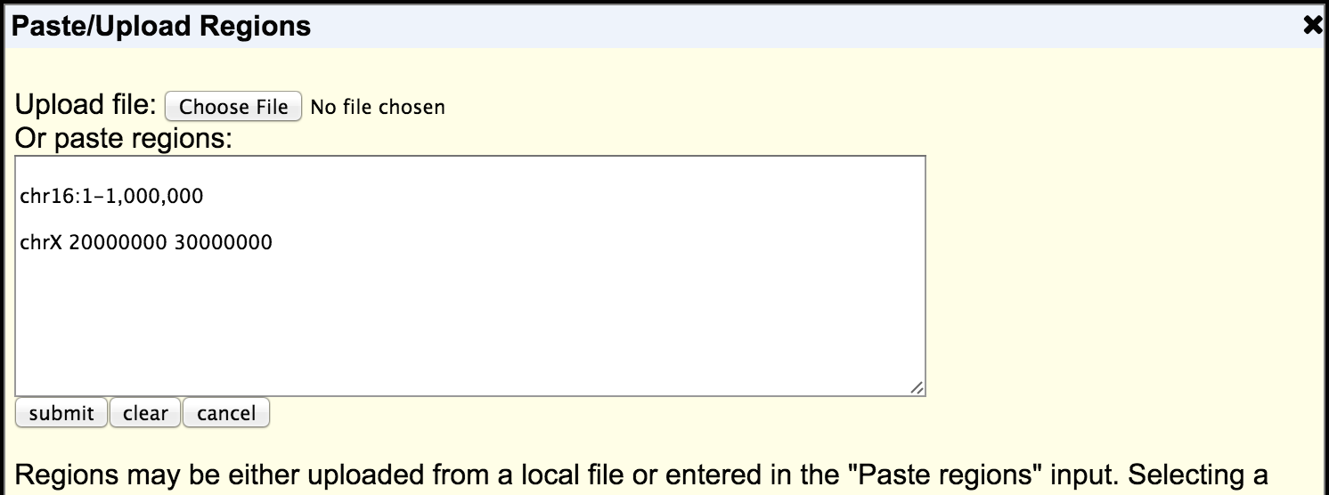
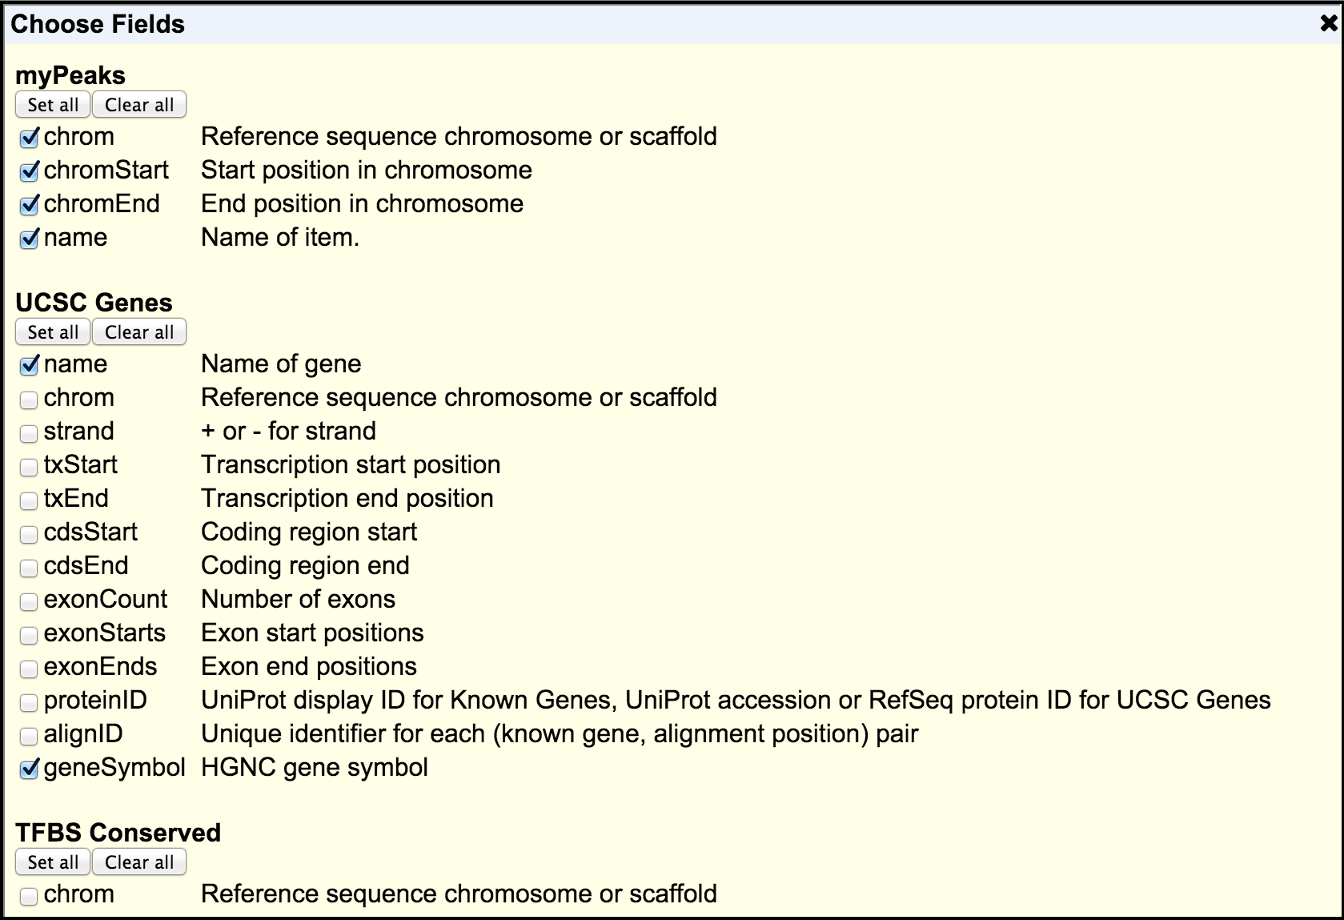
The Data Integrator: a new way to combine data sources underlying the UCSC Genome Browser
Angie S. Hinrichs¹, Kate R. Rosenbloom¹, Matthew L. Speir¹, Donna Karolchik¹, Ann S. Zweig¹, David Haussler^{1,2}, Robert M. Kuhn¹, W. James Kent¹
¹University of California Santa Cruz Genomics Institute, Santa Cruz, CA; ²Howard Hughes Medical Institute, UCSC, Santa Cruz, CA
Introduction
Got variants?
Users of the UCSC Genome Browser have asked us variations of the same question many times over the years:
The Data Integrator is a more flexible and open-ended tool complementary to the Variant Annotation Integrator (VAI).
If you are starting with a list of variant calls, and would like to get predicted functional effects on genes, then create a VCF or pgSnp-formatted custom track and use the VAI.
How can I get the {
… score
gene name
TFBS
} for each of my {
peaks
regions
probes
} ?
While the Table Browser tool can compute the intersections of two tracks by genomic position, it does so by reducing the second track to a set of genomic regions. It does not include any annotation columns of the second track in the output.
We have developed a new tool, the Data Integrator, that can combine data from up to five tracks based on overlap with items in the first track, and output all columns or a selected subset of columns. The output is tab-separated text that can be viewed in the web browser window or downloaded to a local file, optionally compressed by gzip. Like the Genome Browser and Table Browser, the Data Integrator can combine data from the browser database, user custom tracks and hub tracks.
##fileformat=VCFv4.1
Example: get a text file with the overlapping items shown here
Data Integrator
How to build a query
Options
track name=myPeaks
chr16 126700 127200 peakA
chr16 128100 128600 peakB
...
(optional)
Create a custom track or hub track
Choose genome assembly
and regions of interest
Configure data sources
Configure output
#ct_myPeaks_9149.chrom ct_myPeaks_9149.chromStart ct_myPeaks_9149.chromEnd ct_myPeaks_9149.name knownGene.name knownGene.geneSymbol tfbsConsSites.name tfbsConsSites.strand tfbsConsSites.zScore wgEncodeRegTfbsClusteredV3.name wgEncodeRegTfbsClusteredV3.score wgEncodeRegTfbsClusteredV3.expCount wgEncodeRegTfbsClusteredV3.cellType
chr16 126700 127200 peakA uc002cfm.4 MPG V$SOX9_B1 - 2.05 TCF7L2 230 1 HeLa-S3,
chr16 126700 127200 peakA V$SOX5_01 - 2.36 MAZ 604 3 GM12878,HeLa-S3,K562,
chr16 126700 127200 peakA V$AREB6_04 - 1.89 CHD2 128 1 HeLa-S3,
chr16 126700 127200 peakA V$SPZ1_01 - 2.17 GATA2 851 1 HUVEC,
chr16 126700 127200 peakA V$OLF1_01 - 2.04 POLR2A 1000 51 A549,A549,ECC-1,GM12878,GM12878,HCT-116,HeLa-S3,HepG2,HepG2,HUVEC,HUVEC,K562,K562,SK-N-SH,GM10847,GM12878,GM12891,GM12892,GM15510,
GM18505,GM18526,GM18951,GM19099,GM19193,HCT-116,HEK293,HeLa-S3,HepG2,HUVEC,IMR90,K562,K562,K562,K562,K562,MCF10A-Er-Src,MCF10A-Er-Src,
NB4,PBDE,Raji,A549,Gliobla,GM12878,HeLa-S3,HepG2,HUVEC,K562,MCF-7,MCF-7,MCF-7,ProgFib,
...
Get data!
Future work
More information
Some of the features we intend to add:
Filter inputs by value
Configure overlap rules
Reorder output columns
Add columns from related database tables
Search for answers in our mail list archives:
http://genome.ucsc.edu/contacts.html
Email a new question to our actively monitored list:
genome@soe.ucsc.edu
UCSC training (workshops, videos, tutorials):
http://genome.ucsc.edu/training/
Blog: http://genome.ucsc.edu/blog/
Reference:
The UCSC Genome Browser database: 2015 update. Rosenbloom KR, Armstrong J, Barber GP, Casper J, Clawson H, Diekhans M, Dreszer TR, Fujita PA, Guruvadoo L, Haeussler M, Harte RA, Heitner S, Hickey G, Hinrichs AS, Hubley R, Karolchik D, Learned K, Lee BT, Li CH, Miga KH, Nguyen N, Paten B, Raney BJ, Smit AF, Speir ML, Zweig AS, Haussler D, Kuhn RM, Kent WJ. Nucleic Acids Res. 2015 Jan;43(Database issue):D670-81.
Acknowledgements:
This work was funded by National Human Genome Research Institute (5 U41 HG002371-15 to UCSC Center for Genomic Science). We would like to acknowledge the work of the UCSC Genome Bioinformatics technical staff
(http://genome.ucsc.edu/staff.html), our many collaborators, and our users for their feedback and support.
http://genomewiki.ucsc.edu/index.php/BoG2015DataIntegratorPoster

